Slide 1
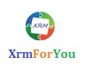
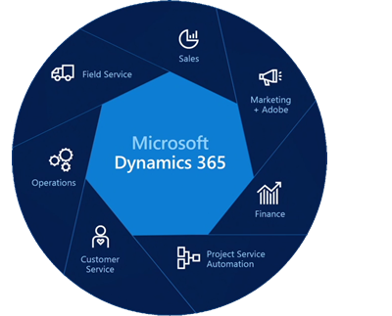
MICROSOFT DYNAMICS 365 TRAINING
Debajit Dutta
Dynamics CRM Most Valuable Professional (MVP)
Cofounder of Xrmforyou.com
BLOG- https://debajmecrm.com
Website: www.xrmforyou.com
Past Work Experience:
Microsoft, SanDisk, Western Digital, PricewaterhouseCoopers

Slide 2
Introduction

Slide 3
Why Microsoft Dynamics CRM?
One of the leading player in the CRM market space
Microsoft Dynamics CRM is unique in the CRM marketplace and is leading the way in innovation and usability across the globe.
The Dynamics CRM platform offers companies a unique set of productivity tools across sales, marketing, and customer service.
Microsoft CRM is differentiated from competitors by its ability to extend and scale across multiple business units, giving companies the ability to leverage their Microsoft CRM investment without the need for additional software.

Slide 4
Why Microsoft Dynamics CRM?
Reporting services
Microsoft Dynamics CRM offers organizations the power of choice in deployment.
Dynamics CRM supports below deployment options
On Premise,
In-the-cloud and
Partner-hosted.

Slide 5
Microsoft Dynamics CRM Deployment Model
Microsoft Dynamics CRM Online
Microsoft Dynamics CRM Online is the best choice for most companies with five or more users
.With CRM Online, Microsoft hosts the application and performs all updates, upgrades, backups and Microsoft also provides technical support.
The cost of CRM Online is determined by the license type. Note that Microsoft requires a minimum of five Professional licenses before a subscriber can add Basic or Essential Licenses
There are no setup fees, but a one-year contract is required.

Slide 6
Microsoft Dynamics CRM Deployment Model
Hosted Microsoft Dynamics CRM
Hosted Microsoft Dynamics CRM is the best choice for companies that need fewer than five users. Hosted Microsoft Dynamics CRM also offers greater flexibility in terms of unsanctioned code, upgrades, and updates. In this model, A Microsoft Partner of your choice hosts the application and performs all updates, upgrades, backups and also provides technical support.
The monthly cost of Hosted Microsoft Dynamics CRM licenses varies according to license type: Professional, Basic, and Essential .There is a minimum of one Professional license for a Hosted Microsoft Dynamics CRM account.

Slide 7
Microsoft Dynamics CRM Deployment Model
The setup fees for Hosted Microsoft Dynamics CRM accounts vary depending on whether the subscriber selects a shared environment or a dedicated environment. The setup fees for a shared environment is most based per user. The setup fees for a dedicated environment start varies on Partner and availability.
On-premises Microsoft Dynamics CRM
On-premises Microsoft Dynamics CRM provides the greatest amount of control over your deployment..
For companies that already have the expertise, hardware, and prerequisite software in place, it also offers the lowest long-term cost of ownership

Slide 8
What’s Happening in the market?

Slide 9
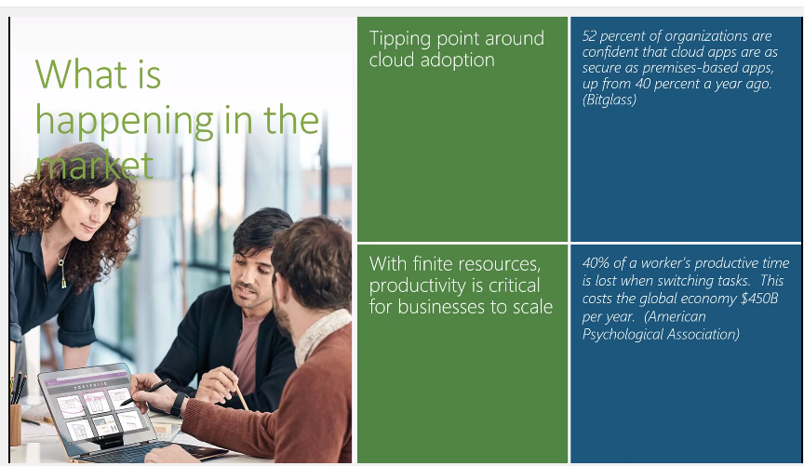
What’s Happening in the market
Notes:
The extensibility platform is the heart of Microsoft Dynamics 365. When you use the Microsoft Dynamics 365 SDK, you are building on top of this system.

Slide 10
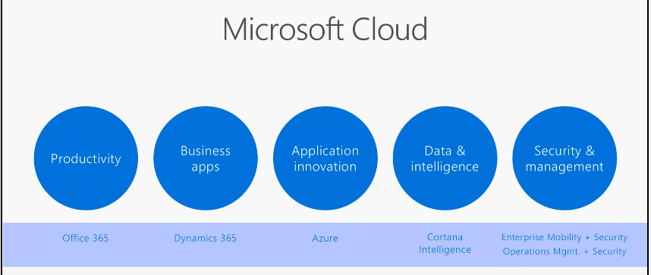
Microsoft’s Vision For Digital Transformation
Notes:
.

Slide 11
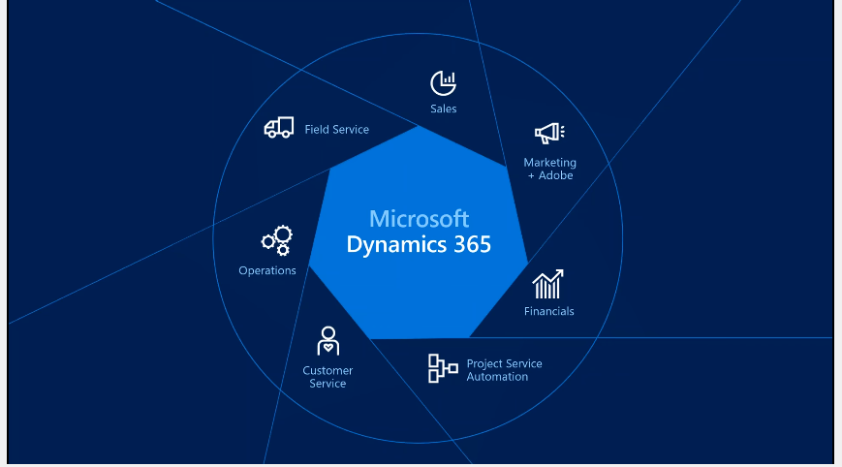
Microsoft Dynamics 365
Notes:
.

Slide 12
What is Dynamics 365 ?
Microsoft’s first Cloud CRM / ERP Offering
Use digital intelligence to reimagine what’s possible for your business. Dynamics 365 unifies CRM and ERP capabilities into applications that work seamlessly together across sales, customer service, field service, operations, financials, marketing, and project service automation. Start with what you need, add applications as your business grows. Rethink what’s possible for your business when you:
Better engage customers
Empower employees
Optimize operations
Reinvent products and business mode

Slide 13
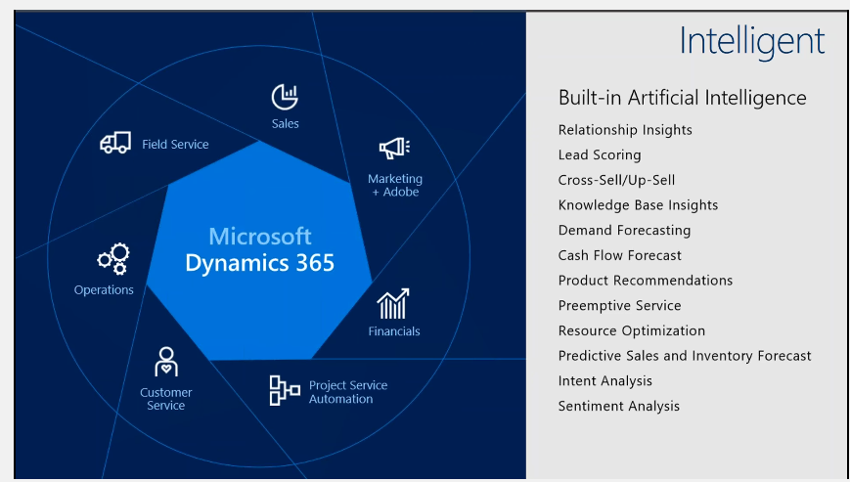
Microsoft Dynamics 365
Notes:
.

Slide 14
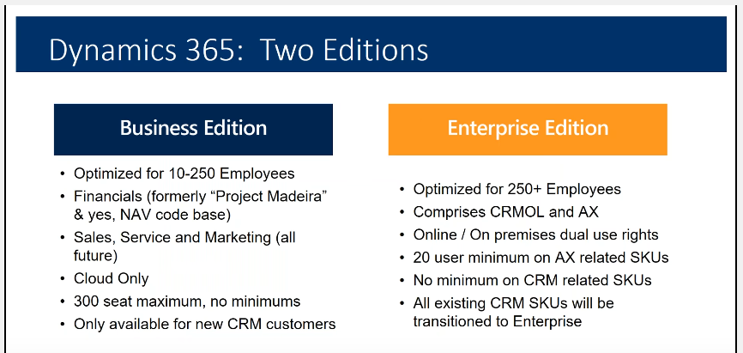
Microsoft Dynamics 365 Editions
Notes:
.

Slide 15
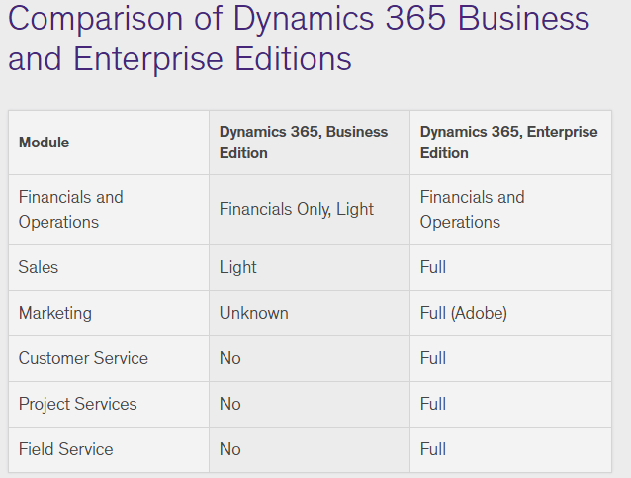
Microsoft Dynamics 365 Editions
Notes:
.

Slide 16
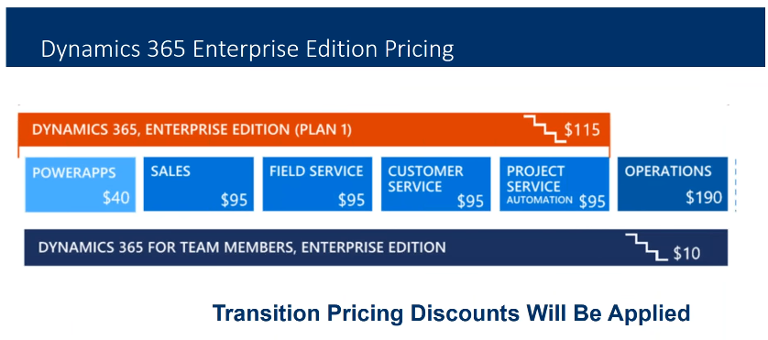
Microsoft Dynamics 365 Editions
Notes:
.

Slide 17
Business Eco System

Slide 18
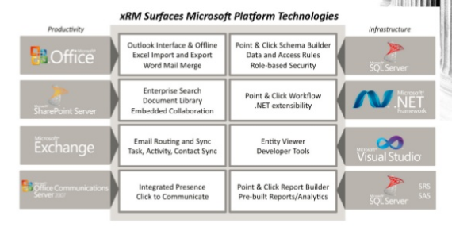
Microsoft Dynamics CRM and Microsoft stack
Notes:
.

Slide 19
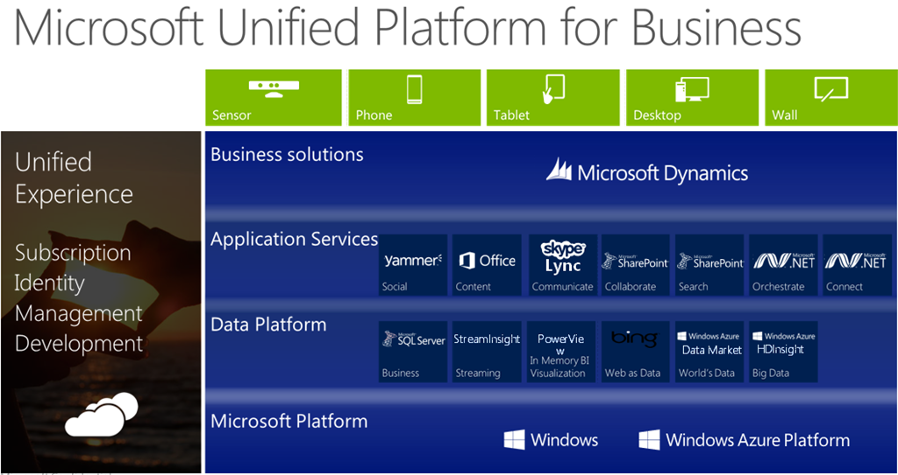
Microsoft Dynamics CRM and Microsoft stack
Notes:
.

Slide 20
Microsoft Dynamics CRM and Microsoft stack
One of the most powerful propositions of Microsoft Dynamics CRM is the integration with the Microsoft stack. The Microsoft stack consists of products such as
Windows Server,
Microsoft Exchange,
Microsoft Office
Microsoft Lync,
Microsoft SharePoint, and
Yammer.
This stack helps give an end-to-end solution designed to work together and increase the value of technology in your business.

Slide 21
Microsoft Dynamics CRM and Microsoft stack
This stack helps give an end-to-end solution designed to work together and increase the value of technology in your business.
Exchange and Outlook. Dynamics CRM integrates with Exchange and Microsoft Outlook. Exchange and Outlook by itself is a leading business email, calendar and contact solution. Combining Dynamics CRM with Exchange and Outlook allows the end user to interact with CRM in a convenient and familiar user interface.
Microsoft Lync. This tool enables easy communication to internal company contacts and external partners and customers. Dynamics CRM integrates tightly with Lync allowing presence information (Available, Busy, and Away) to be seen at a glance, and provides out-of-the-box click-to-dial integration with CRM when working on customer records.

Slide 22
Microsoft Dynamics CRM and Microsoft stack
Yammer. This enterprise social network platform integrates with Dynamics
CRM to allow expertise in your organization to be shared efficiently to acquire new customers and provide great service to existing one. All of this expertise shared through this internal social platform is then stored on the related CRM record automatically so others can review it at any time.
SharePoint. As information comes together during interaction with customers, business documents will be generated throughout the lifecycle. Dynamics CRM integrates with SharePoint creating a consistent folder structure to store and organize documents while making them easily accessible in the related CRM records—regardless if that is an account, contact, opportunity, case or a custom record type.
All of these technologies that integrate and enhance Dynamics CRM are available as service-as-a-subscription (SaaS) cloud options or on premise deployments to give the customer the ultimate power of choice.

Slide 23
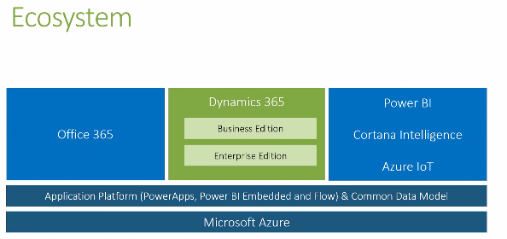
Microsoft Dynamics 365 Online Ecosystem
Notes:
.

Slide 24
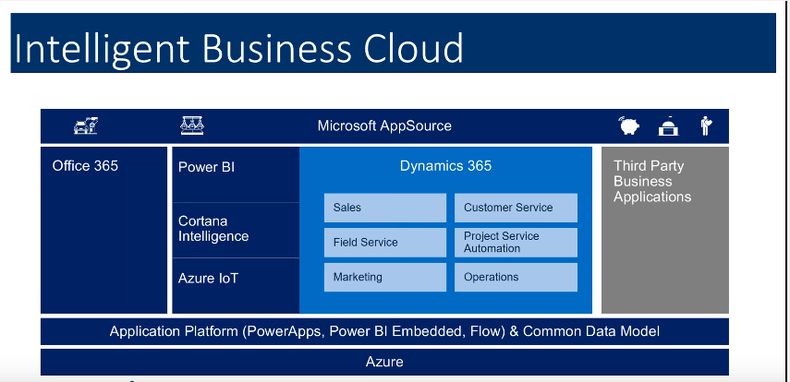
Microsoft Business Cloud
Notes:
.

Slide 25
Dynamics 365 App Model

Slide 26
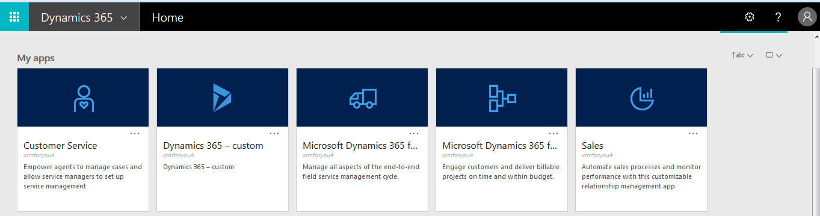
Microsoft Dynamics 365 App Model
Notes:
.

Slide 27
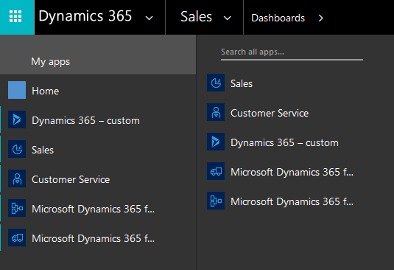
Microsoft Dynamics 365 App Model
Notes:
.

Slide 28
Microsoft Dynamics 365 App Model
Microsoft introduced a new “App” model to Dynamics 365 (version 8.2+). You can package up a set of entities, dashboards, forms, views, charts, and business processes to create an “App”.
All of these technologies that integrate and enhance Dynamics CRM are available as service-as-a-subscription (SaaS) cloud options or on premise deployments to give the customer the ultimate power of choice.
Currently, OOB, Dynamics 365 comes with Sales, Customer Service, Field Service, and Project Service Automation.
If you navigate to the “Sales App”, you’ll see that only Entities related to Sales is visible.
If you have a closer look at the URL, you’ll notice that there’s a appid query string. This is used to load Dynamics 365 with the correct App.

Slide 29
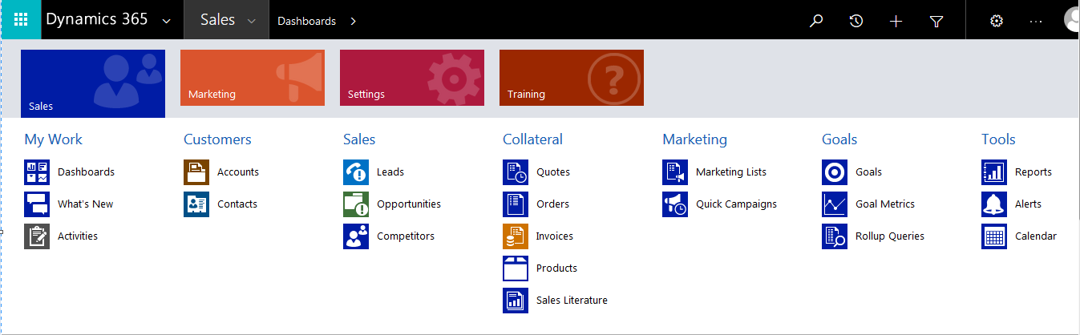
Microsoft Dynamics 365 App Model : Sales App
Notes:
.

Slide 30
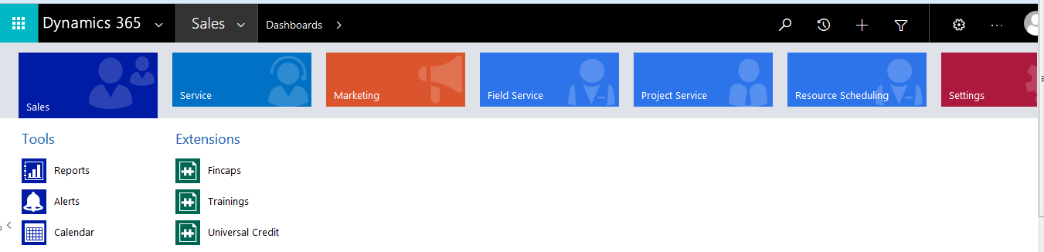
Microsoft Dynamics 365 App Model : Custom App
You’ll also notice another Tile for the default App. This is named “Dynamics 365 – custom”. This App includes all components of the system by default. Note: The URL is doesn’t include the appid query string since this is the default App.
While you are inside an App, you can navigate to another App using the Task Pane. Click on the arrow next to the text Dynamics 365 on the menu bar.

Slide 31
Microsoft Dynamics 365 App Model : Change the Custom App Name
If you would like to change the custom App name, you can do this using a System Setting.
Navigate to
Settings > Administration > System Settings.
Click the General tab, scroll down to the bottom. Change the value in the “Default app name” field.
You can also choose to show or hide by switching the “Show default app on landing page and in app switcher” radio button. Click OK.

Slide 32
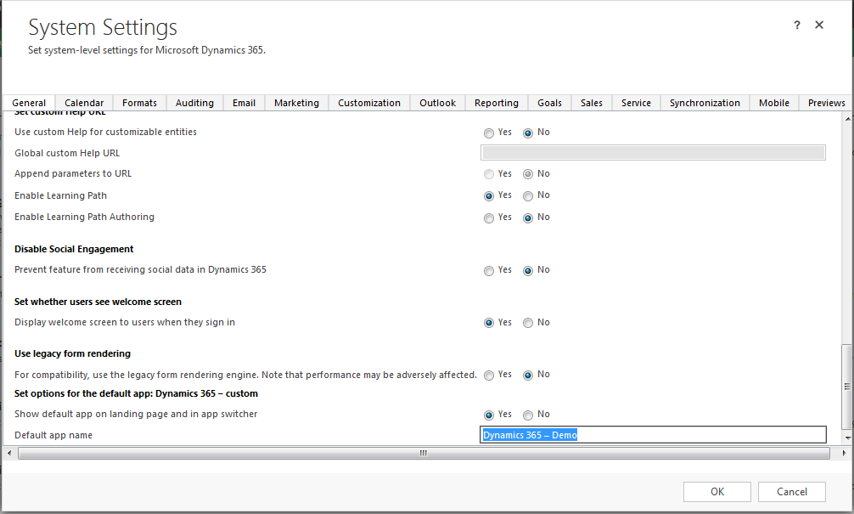
Microsoft Dynamics 365 App Model : Change the Custom App Name

Slide 33
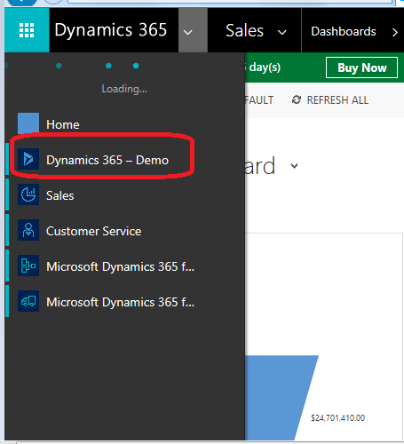
Microsoft Dynamics 365 App Model : Change the Custom App Name

Slide 34
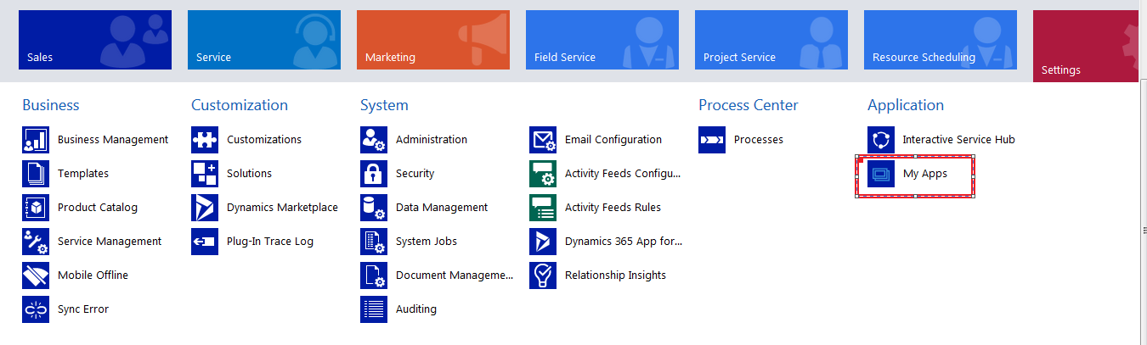
Create Apps in Dynamics 365 using App Designer and Site Map Designer
Similar to the apps that we see in Menu Bar for Dynamics 365, we can create our own apps.
Go to Settings → My Apps.

Slide 35
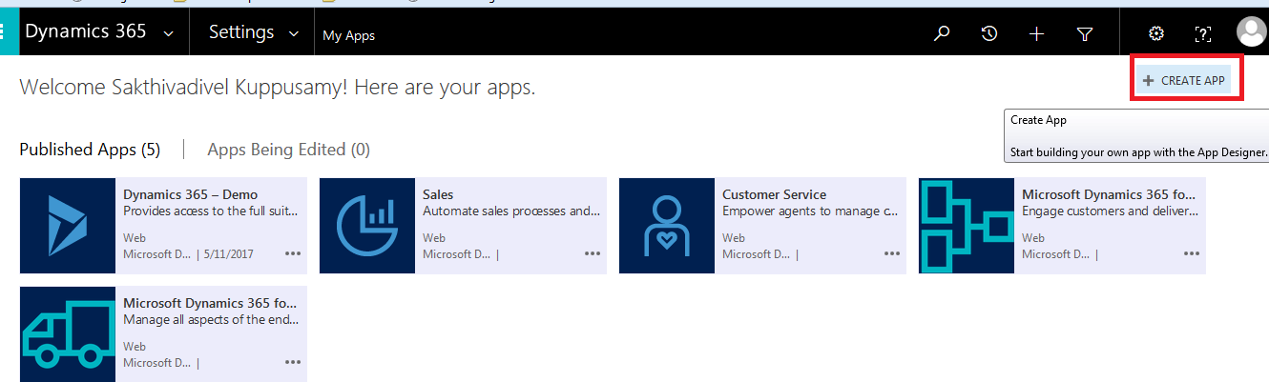
Create Apps in Dynamics 365 using App Designer and Site Map Designer
Click on Create App

Slide 36
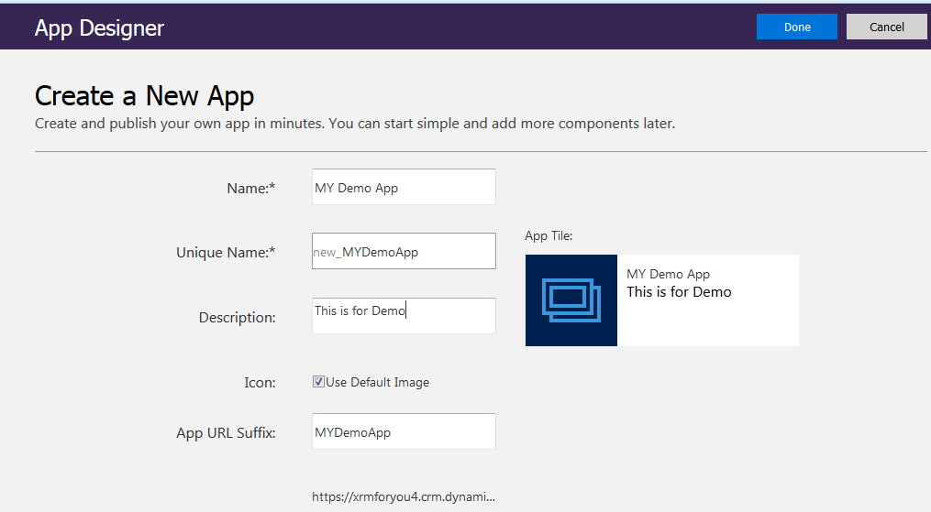
Create Apps in Dynamics 365 using App Designer and Site Map Designer
It will take us to App Designer, provide details.

Slide 37
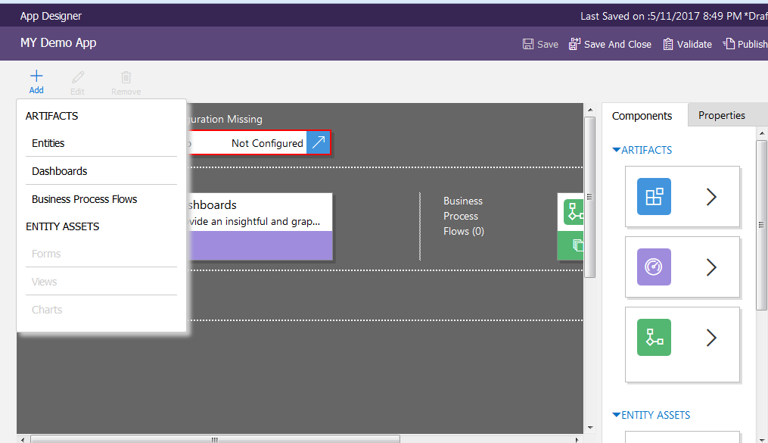
Create Apps in Dynamics 365 using App Designer and Site Map Designer
Different components that we can add.

Slide 38
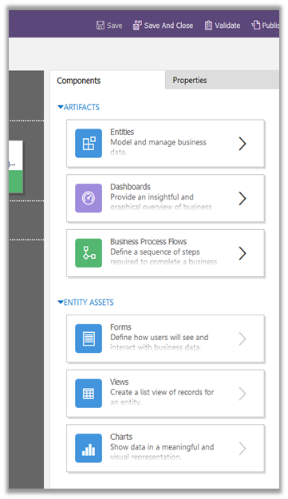
Create Apps in Dynamics 365 using App Designer and Site Map Designer
Or drag and drop.

Slide 39
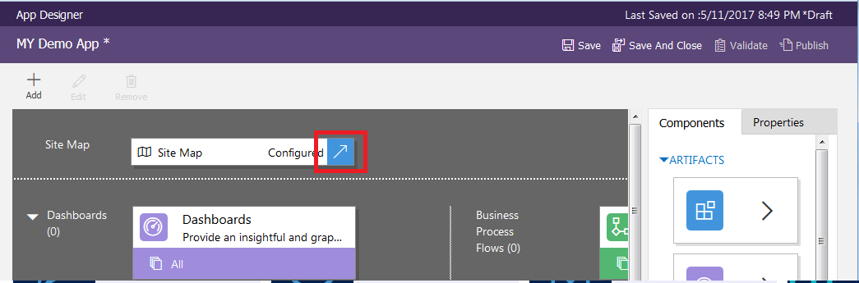
Create Apps in Dynamics 365 using App Designer and Site Map Designer
First we need to configure the Sitemap for the app. Click on arrow inside Sitemap area to configure.

Slide 40
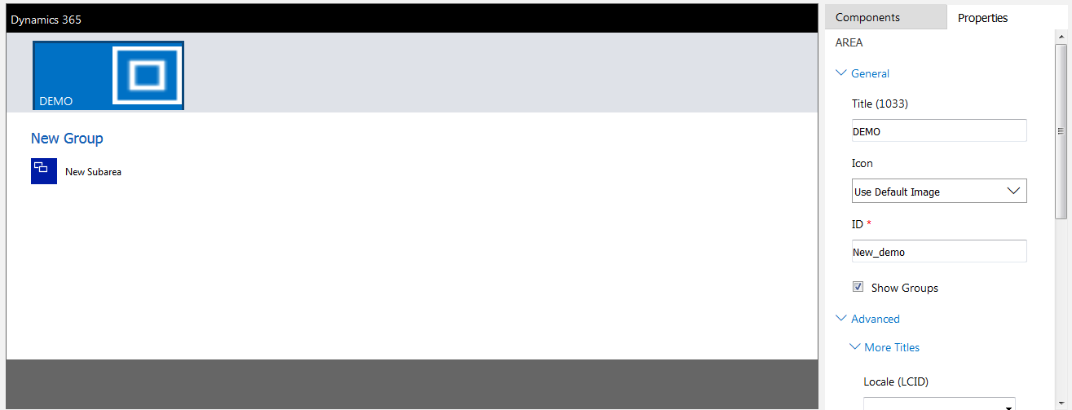
Create Apps in Dynamics 365 using App Designer and Site Map Designer
Update properties of Area, Group and Subarea and add new Sub Areas.
AREA PROPERTIES

Slide 41
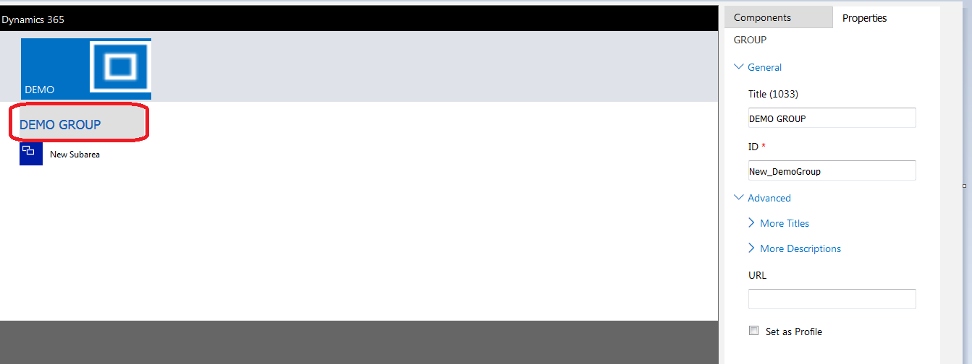
Create Apps in Dynamics 365 using App Designer and Site Map Designer
GROUP PROPERTIES

Slide 42
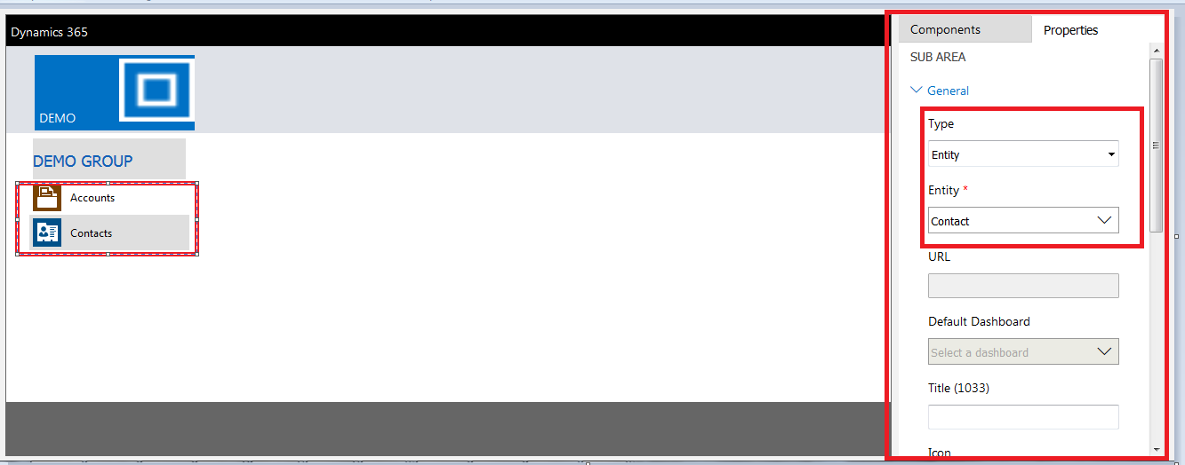
Create Apps in Dynamics 365 using App Designer and Site Map Designer
SUB AREA PROPERTIES

Slide 43
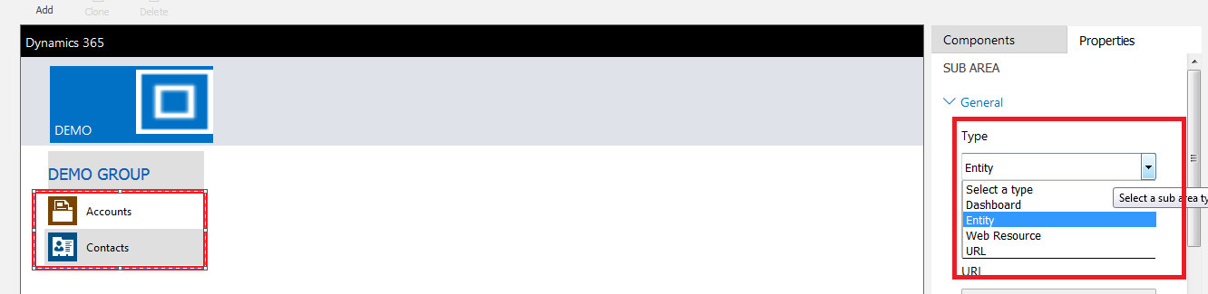
Create Apps in Dynamics 365 using App Designer and Site Map Designer
TYPES OF SUB AREA CAN BE DEFINED

Slide 44
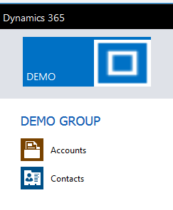
Create Apps in Dynamics 365 using App Designer and Site Map Designer
This is how the app looks inside Site Map Designer

Slide 45
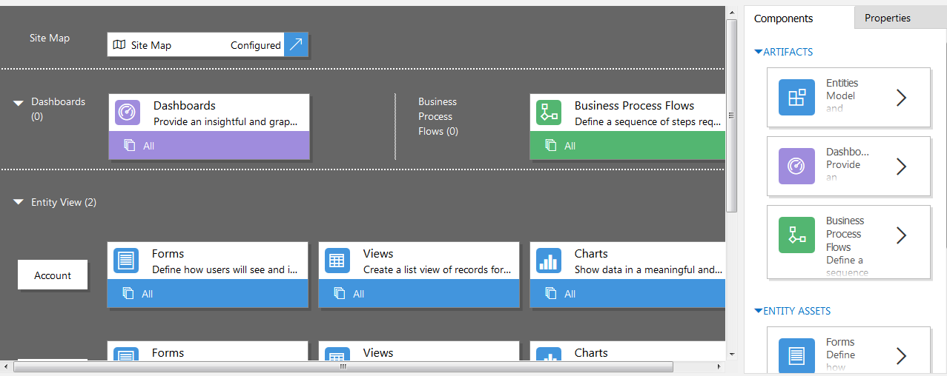
Create Apps in Dynamics 365 using App Designer and Site Map Designer
Save and close to go back to App Designer
Notes:
It has added Dashboard along with Account and Contact Entity View.

Slide 46
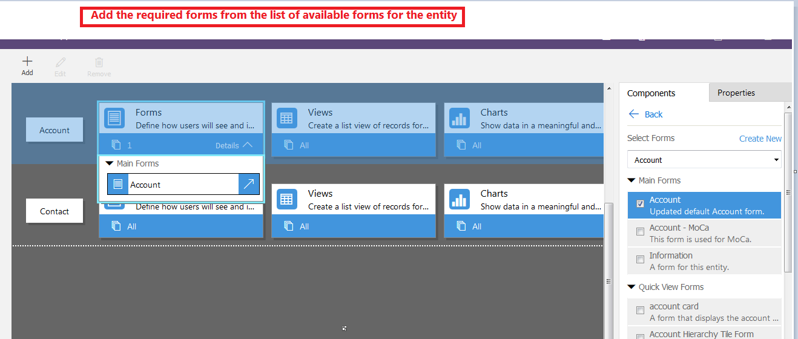
Create Apps in Dynamics 365 using App Designer and Site Map Designer
Notes:
Now let us add Forms for respective entities in the designer
Select Each entity ( here Account & Contact )in Entity View and select Forms in Entity Assets and select the views and charts as shown in the slides

Slide 47
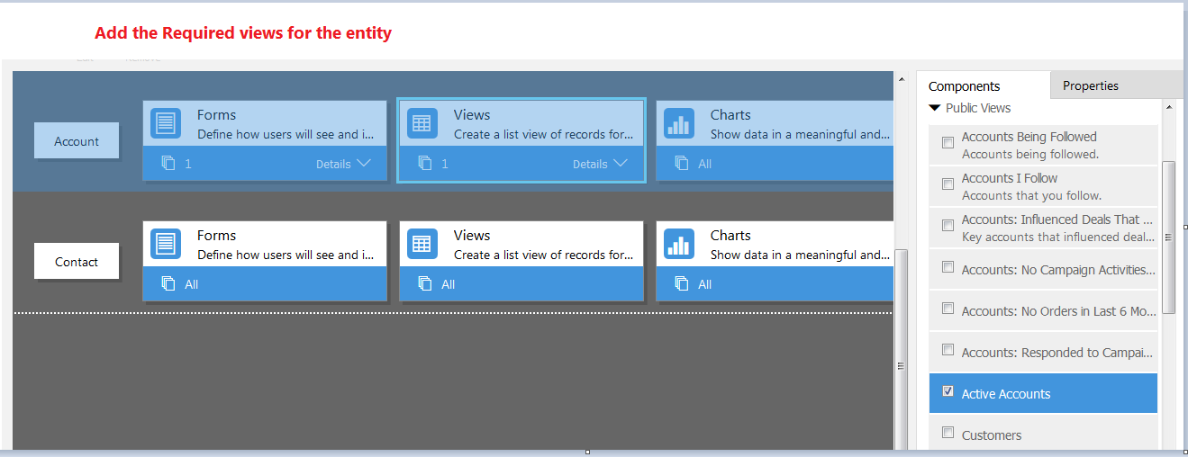
Create Apps in Dynamics 365 using App Designer and Site Map Designer
Notes:
Add the Required views of the Entity

Slide 48
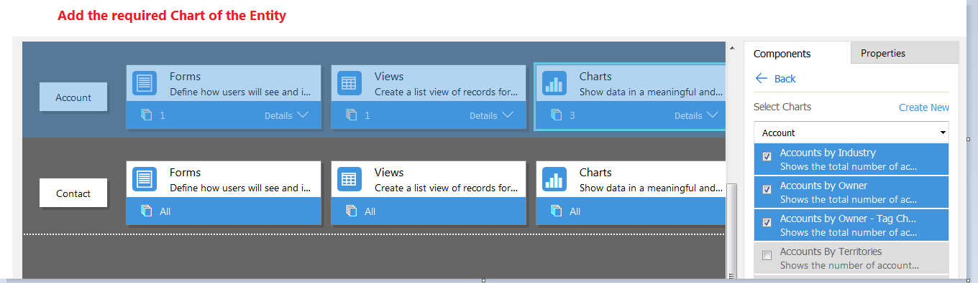
Create Apps in Dynamics 365 using App Designer and Site Map Designer
Notes:
Add the Required Charts of the Entity.
Repeat these steps for Contact Entity Also.

Slide 49
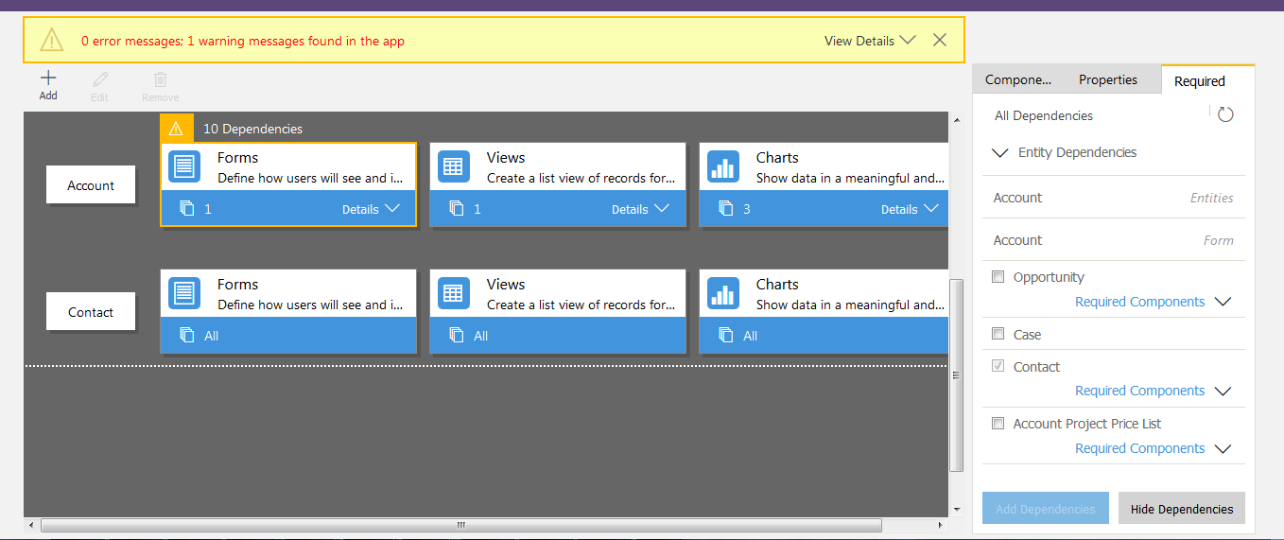
Create Apps in Dynamics 365 using App Designer and Site Map Designer
Notes:
Click on Validate and it will show all dependencies

Slide 50
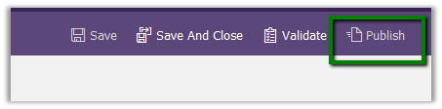
Create Apps in Dynamics 365 using App Designer and Site Map Designer
Notes:
Save and Publish the app

Slide 51
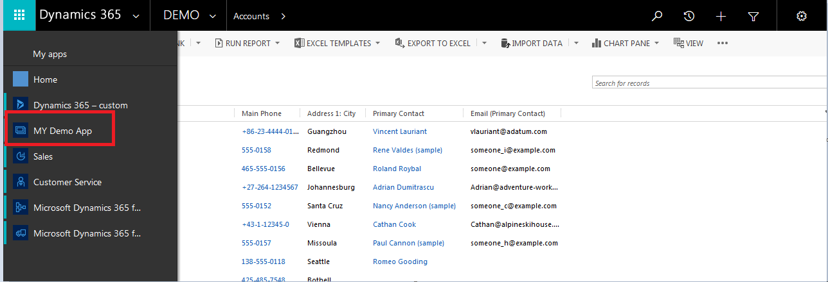
Create Apps in Dynamics 365 using App Designer and Site Map Designer
Notes:
Save and Publish the app

Slide 52
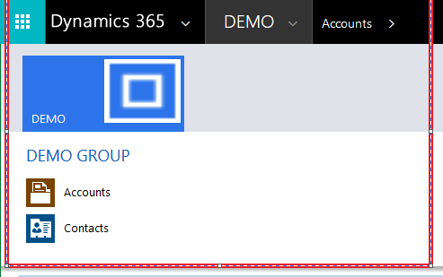
Create Apps in Dynamics 365 using App Designer and Site Map Designer See the App we created as Below
Notes:
See the App we created as shown on this slide

Slide 53
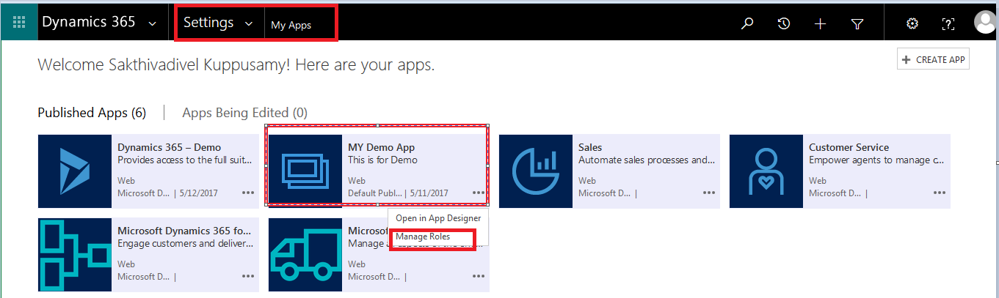
Manage Apps using new App Designer in Dynamics 365
Go to SETTINGS → MY APPS and then you can find your app
Notes:
Click on “Manage Roles”

Slide 54
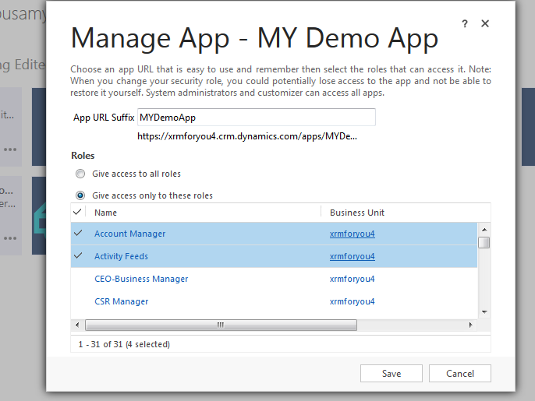
Manage Apps using new App Designer in Dynamics 365
Notes:
Select the Security Roles for which you want to give access to this App.

Slide 55
Architecture And Security Model

Slide 56
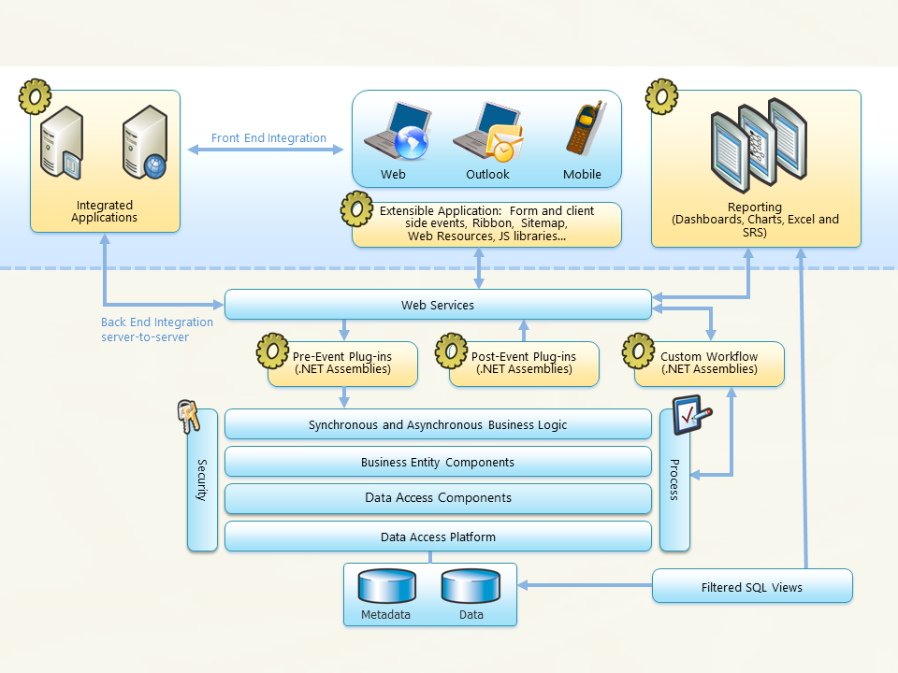
MSCRM Architecture
Notes:
The extensibility platform is the heart of Microsoft Dynamics 365. When you use the Microsoft Dynamics 365 SDK, you are building on top of this system.

Slide 57
Components of the MSCRM Platform
Microsoft SQL Server database
Web services
System services (workflow, metadata, and integration)
A query processor that supports the entity model
Secured ad hoc queries that use an XML fetch statement to protect the physical database
Plug-ins for business logic extensibility
Reporting services

Slide 58
Security
Security in Dynamics CRM is implemented through
Authentication : Allowing users to enter into Dynamics CRM application based on the credentials provided by the user.
Authorization : Allowing the users to access only the data on which they have access in Dynamics CRM application.
Security
Authentication
Authorization

Slide 59
Types of Authentication
Microsoft Dynamics CRM supports three security models for Authentication
Integrated Windows authentication,
claims-based authentication,
Office 365 authentication
The type of authentication used depends on the below things as
Type of deployment your application is accessing,. (On- Premise , CRM-Online)
Accessing on Intranet or Internet (IFD)

Slide 60
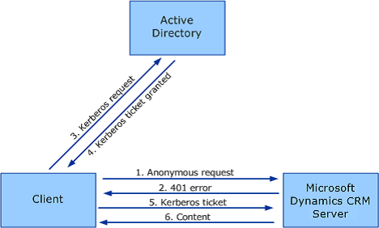
Integrated Windows authentication
This mode of Authentication works only in the scenario of accessing an On-Premise deployment of Dynamics CRM application over the Intranet (Company Network).
All users are members of Microsoft of Dynamics CRM application should be the members of your Active Directory (AD) domain.

Slide 61
Claims-based authentication
This mode of Authentication is used to host your company’s On-Premise deployment of Dynamics CRM application over the Internet(IFD).
Users who are not members of Company (Partners, suppliers etc.) can be given access to your Dynamics CRM application.
Users of the Company can continue to use their AD credentials.
This mode works both on Intranet and Internet allowing users seamlessly to access Dynamics CRM application on the Go.
Claims based authentication for Dynamics CRM IFD depends mainly on Active Directory Federation Services (ADFS) to allow for secure, supported, and efficient claims-based authentication into Dynamics CRM environments, as well as a secure SSL encrypted Internet Facing Deployment.

Slide 62
Important Components & Prerequisites of Claims-based authentication
Claims-Based Authentication involves below main components:
Configuration of your network (firewall, internal and external DNS, etc.)
Proper configuration of the Dynamics CRM Deployment Manager, and
Installation and configuration of a separate piece of software, known as AD FS 2.0.

Slide 63
Important Components & Prerequisites of Claim-based authentication
Before configuring Microsoft Dynamics CRM Server for claims-based authentication, you should have a solid understanding of the following:
The Microsoft Dynamics CRM Server installation process.
Security token-based authentication as used in claims-based authentication.
AD FS installation and configuration.
Public key infrastructure (PKI) administration and digital certificates.

Slide 64
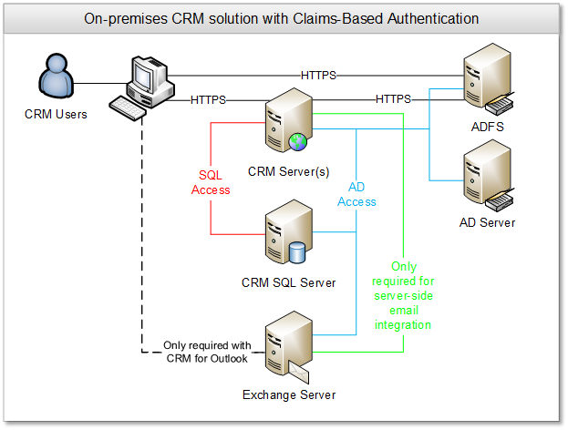
Claims-based authentication

Slide 65
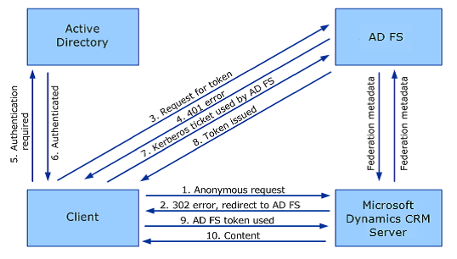
Types of Claims-based authentication
Claims-based authentication: internal access
If you have a multiple domain environment where trust does not exist between the domains, or where some users exist in a different attribute store such as a partner organization, you can use claims-based authentication to handle internal user authentication.

Slide 66
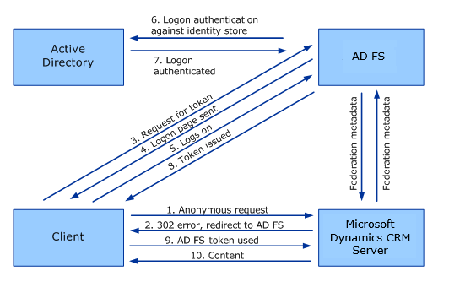
Types of Claims-based authentication
Claims-based authentication: external access
The main difference between internal vs. external access is that Kerberos tickets are not used in external authentication. When a user navigates to the CRM website, they are redirected to AD FS and prompted to login. If there exists more than one trusted claims provider in AD FS (Active Directory is the only claims provider by default), the user will select a claims provider. Users then login and the credentials are validated by AD FS.

Slide 67
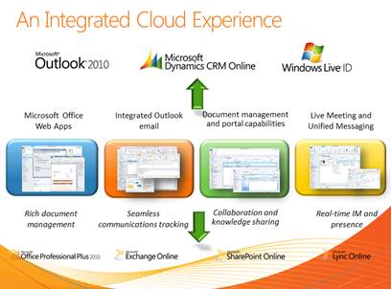
Office 365 authentication
This mode of authentication works only with Microsoft Dynamics CRM Online.
Every users who needs access to CRM needs to have a office 365 account.

Slide 68
Security Model of Microsoft Dynamics CRM
Authorization in CRM is implemented by Microsoft Dynamics CRM Security model.
You use the security model in Microsoft Dynamics CRM to protect the data integrity and privacy in a Microsoft Dynamics CRM organization.
The security model also promotes efficient data access and collaboration. The goals of the model are as follows :
Provide a multi-tiered licensing model for users.
Grant users access that allows only the levels of information required to do their jobs.
Categorize users and teams by security role and restrict access based on those roles.

Slide 69
Security Model of Microsoft Dynamics CRM
Support data sharing so that users can be granted access to objects they do not own for a one-time collaborative effort.
Prevent access to objects a user does not own or share.
You combine business units, role-based security, record-based security, and field-based security to define the overall access to information that users have in your Microsoft Dynamics CRM organization.
Role-based security in Microsoft Dynamics CRM focuses on grouping a set of privileges together that describe the responsibilities (or tasks that can be performed) for a user. Microsoft Dynamics CRM includes a set of predefined security roles. Each aggregates a set of user rights to make user security management easier. Also, each application deployment can define its own roles to meet the needs of different users.

Slide 70
Security Model of Microsoft Dynamics CRM
Record-based security or Object based security in Microsoft Dynamics CRM focuses on access rights to specific records. Access Teams : Access Teams have been introduced in MSCRM 2013 to effectively manage record based security.
Field-level security restricts access to specific high business impact fields in an entity only to specified users or teams. Field-level security is managed by the security profiles; only secure fields are available for configurations.
Form Based Security : Control Users and Teams access rights to specific forms of entities. We can have different forms of an entity for different security roles in CRM.
When users have multiple security roles the form which loads will be controlled by form order. If Role based forms fails the system will load the default failover form of the entity in CRM.

Slide 71
Business Units
In Microsoft Dynamics CRM, a business unit is a logical grouping of related business activities.
If your CRM organization is structured around departments or divisions that have separate products, customers, and marketing lists, you might want to create business units.
Business units are mapped to an organization’s departments or divisions.
Business units are mapped to an organization’s departments or divisions. Users can securely access data in their own business unit, but they can’t access data in other business units.
Business units, security roles, and users are linked together in a way that conforms to the Microsoft Dynamics CRM role-based security model.

Slide 72
Business Units
Use business units together with security roles to control data access so people see just the information they need to do their jobs.
Keep the following in mind when creating business Units :
The organization (also known as the root business unit) is the top level of a Microsoft Dynamics CRM business unit hierarchy. CRM automatically creates the organization when you install or provision CRM. You can’t change or delete the organization name.
Each business unit can have just one parent business unit.
Each business unit can have multiple child business units.

Slide 73
Business Units
CRM security roles and users are associated with a business unit. You must assign every user to one (and only one) business unit.
You can assign a team to just one business unit, but a team can consist of users from one or many business units. Consider using a team if you have a situation where users from different business units need to work together on a shared set of records.

Slide 74
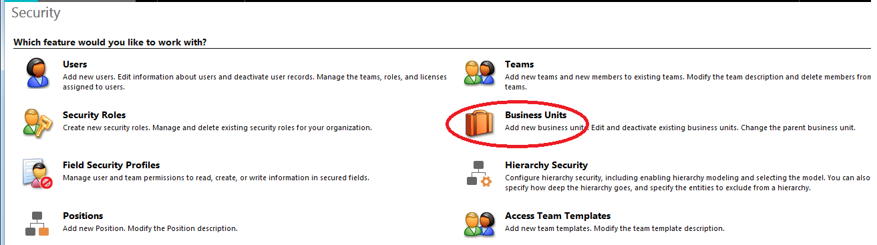
Business Units

Slide 75
Business Units

Slide 76
Security Roles and Privileges
To control data access, you must set up an organizational structure that both protects sensitive data and enables collaboration. You do this by setting up business units, security roles, and field security profiles.
A security role defines how different users, such as salespeople, access different types of records. To control access to data, you can modify existing security roles, create new security roles, or change which security roles are assigned to each user.
Each user can have multiple security roles and security role privileges are cumulative: having more than one security role gives a user every privilege available in every role.
Each security role consists of record-level privileges and task-based privileges.

Slide 77
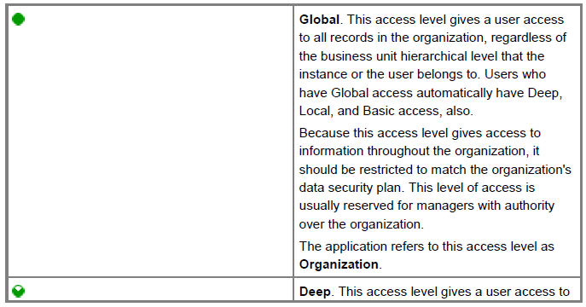
Security Roles and Privileges

Slide 78
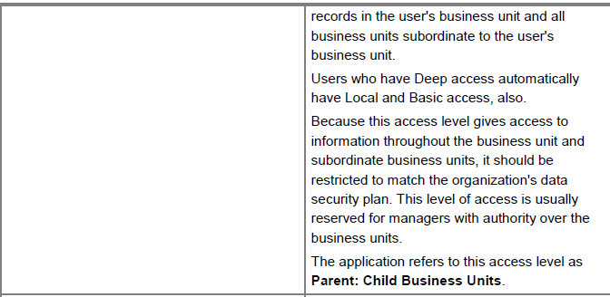
Security Roles and Privileges

Slide 79
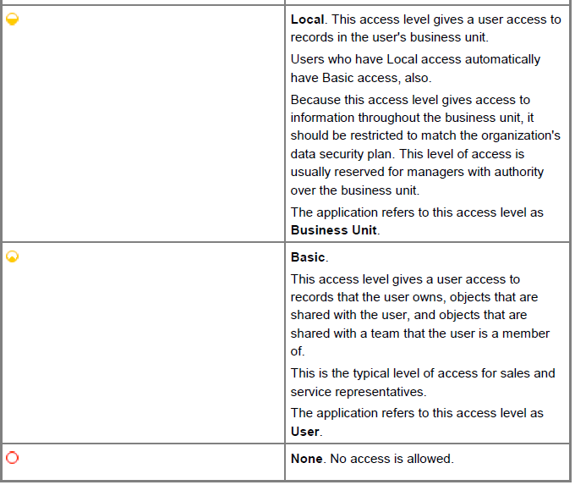
Security Roles and Privileges

Slide 80

Security Roles and Privileges

Slide 81

Security Roles and Privileges

Slide 82

Security Roles and Privileges

Slide 83

Security Roles and Privileges

Slide 84

Security Roles and Privileges

Slide 85

Security Roles and Privileges

Slide 86

Copy a Security Role

Slide 87

Copy a Security Role

Slide 88
Field Level Security
Record-level permissions are granted at the entity level, but you may have certain fields associated with an entity that contain data that is more sensitive than the other fields. For these situations, you use field level security to control access to specific fields.
The scope of field level security is organization-wide and applies to all data access requests including the following :
Data access requests from within a client application, such as web browser, mobile client, or Microsoft Dynamics CRM for Outlook.
Web service calls using the Microsoft Dynamics CRM SDK (for use in plug-ins, custom workflow activities, and custom code).
Reporting (using Filtered Views)

Slide 89

Field Level Security
Unless one or more security profiles are assigned to a security enabled field, only Microsoft Dynamics CRM users with the system administrator security role will have access to the field.

Slide 90

Field Level Security

Slide 91

Field Level Security

Slide 92

Field Level Security

Slide 93

Field Level Security

Slide 94

Field Level Security

Slide 95
Access Teams
Access Teams are a new type of team in Dynamics CRM 2013 which is used to implement record based security effectively.
Accesses records for access teams are implemented through sharing .
Access Teams can be enabled / disabled at the entity level in Dynamics CRM.
Access Teams can be manually created for individual records on the fly or can be automated through Access Team Templates in CRM.
For a user to get access on a record , the user has to be simply added to the access team.
Sharing privileges are defined by an access team template but don't change dynamically for existing records if the template changes.

Slide 96
Access Teams
An sub grid has to be added to the entity form to view the access team members and new users can be added to the access team through this sub grid on form.
Access Teams cannot be assigned with a security role or cannot own records in CRM.
While manual creation of Teams, team type has to be selected during the team creation and cannot be changed once created.
Access Teams and Access team templates cannot be added to a solution as a solution component and Export / Import between CRM environments.

Slide 97
Access Teams
To move access team templates across environments , you can use Access Team Migrator tool developed by Debajit Dutta.
You can download this tool from below code plex link.
https://accessteamsmigrator.codeplex.com/releases/view/618241

Slide 98

Access Teams

Slide 99

Access Teams

Slide 100
Access Team Template

Slide 101
Access Team Sub Grid on the Form

Slide 102
Hierarchy Security
Hierarchy security :
The hierarchy security model is an extension to the existing Microsoft Dynamics CRM security model.
It can be used in conjunction with all other existing security models. The hierarchy security offers a more granular access to records for an organization.
This helps any organization to maintain the org structure and have tight control over the data integrity.
Hierarchy Security
Position Security
Manager Security

Slide 103

Hierarchy Security

Slide 104

Hierarchy Security

Slide 105
Manager Hierarchy
The Manager hierarchy security model is based on the management chain or direct reporting structure, where the manager’s and the report’s relationship is established by using the Manager field on the system user entity.
With the Manager hierarchy security model, a manager has access to the records owned by the user or by the team that a user is a member of, and to the records that are directly shared with the user or the team that a user is a member of.
In addition to the Manager hierarchy security model, a manager must have at least the user level Read privilege on an entity, to see the reports’ data.
For example, if a manager doesn’t have the Read access to the Case entity, the manager won’t be able to see the cases that their reports have access to.

Slide 106
Manager Hierarchy
For a direct report, the manager has the Read, Write, Update, Append, AppendTo access to the report’s data.
For a non-direct report, a manager has the Read-only access to the report’s data
In addition to the Manager hierarchy security model, a manager must have at least the user level Read privilege on an entity, to see the reports’ data.
The depth of the Manager hierarchy can be configured through Hierarchy Depth.
The Manager hierarchy works only if the Manager and Reports belongs to same business unit in CRM.

Slide 107

Manager Hierarchy

Slide 108

Position Hierarchy

Slide 109
Position Hierarchy
The Position hierarchy is not based on the direct reporting structure, like the Manager hierarchy. A user doesn’t have to be an actual manager of another user to access user’s data.
Custom Positions can be defined based on your company needs and then these positions can be arranged in Position hierarchy.
Multiple users can be added to the one position and one user can be tagged only with one position in a given hierarchy.
Users at the higher positions in the hierarchy have Read, Write, Update, Append, AppendTo access to the data of the users at the lower positions in the direct ancestor path.
The non-direct higher positions, have Read-only access to the lower positions’ data in the direct ancestor path.

Slide 110
Position Hierarchy
With the Position hierarchy security, a user at a higher position has access to the records owned by a lower position user or by the team that a user is a member of, and to the records that are directly shared to the user or the team that a user is a member of.
The depth of the position security can be Configured in Hierarchy Depth.
The position hierarchy works only with in the same business unit in CRM.
With the Position hierarchy security, a user at a higher position has access to the records owned by a lower position user or by the team that a user is a member of, and to the records that are directly shared to the user or the team that a user is a member of.

Slide 111
Position Hierarchy
In addition to the Position hierarchy security model, the users at a higher level must have at least the user level Read privilege on an entity to see the records that the users at the lower positions have access to. For example, if a user at a higher level doesn’t have the Read access to the Case entity, that user won’t be able to see the cases that the users at a lower positions have access to

Slide 112

Position Hierarchy

Slide 113


Slide 114
Q&A

Slide 115
Configurations and Customizations

Slide 116

Navigation Features
The Command Bar utilizes the three line stack button known as the switch module.
The switch module shows all options under groups they belong with.

Slide 117

Navigation Features : Pin Items
Additionally, users can pin items that they use frequently and want to save. This makes for an easy and efficient way to find commonly used services in CRM.

Slide 118

Navigation Features : Pin Items

Slide 119

Navigation Features : Recently Viewed Records

Slide 120
Introduction To Customization
The way your organization works is unique. Some organizations have well-defined business processes that they apply using Microsoft Dynamics CRM. Others aren’t happy with their current business processes and use CRM to apply new data and processes to their business. Whatever situation you find yourself in, you’ll find a lot of customization capabilities in CRM so that it can work for your organization.
Today, modern business applications use a metadata-driven architecture so that people can customize the application without writing code. Metadata means “data about data” and it defines the structure of the data stored in the system. With this metadata, an application knows about any changes to the data structure and this enables the application to adapt as the data structure changes. Since the metadata is known, additional capabilities can be included that are tied to the metadata.

Slide 121
Introduction To Customization
When you customize Microsoft Dynamics CRM using the customization tools in the application, you’re adding or updating the metadata or data used by features that depend on the metadata. Because we know the kinds of data used to customize the system, we can take this data into account and add new features to CRM without breaking your system. This way you should always be able to apply an update rollup or upgrade to the latest version and enjoy the best new features.
We expect that you can do most of your customization with the tools in the application. Everything you do by using those tools is supported by Microsoft because they apply changes to the metadata or data that depends on the metadata..

Slide 122
Supported Customization
But, if the customization tools don’t meet your needs, you can install a solution provided by a third party or hire a developer to code your customizations. Either way, it’s good for you to understand supported customizations. If you need to invest in a solution that requires code, you should make sure that the code is written using only supported APIs. This helps you protect your investment in both CRM and any solutions you get..
Developers who extend Microsoft Dynamics CRM have a responsibility to follow rules and best practices documented in the SDK. The SDK documents the APIs available to developers and provides guidance about how to best use them. Microsoft supports only the APIs and practices that are documented in the SDK. You may find something on the Internet that describes how you can solve a problem, but if it doesn’t leverage APIs documented in the SDK, it isn’t supported by Microsoft. Before you have a developer apply a change you should verify whether it uses supported methods.

Slide 123
Supported Customization
If developers use the APIs and best practices described in the SDK we can be sure to test whether any of the changes we make to CRM has the potential to break existing customizations. Our goal is that code customizations written using supported methods will continue to work when new versions or updates of CRM are released. You benefit because you can upgrade to new versions with improved features without having developers change their code each time.
If we detect that a change in a new version of CRM will cause a supported customization to break, we will document what is affected and how people can change their code to fix it.

Slide 124
Unsupported Customization
Just because certain APIs and programming practices aren’t supported by Microsoft doesn’t mean that they don’t work. “Unsupported by Microsoft” means exactly what it says: you can’t get support about these APIs or programming practices from Microsoft. We don’t test them and we don’t know if something we change will break them. We can’t predict what will happen if someone changes code in our application.
The developer who uses unsupported APIs and programming practices assumes the responsibility to support their code. They will need to test their code to make sure it works.
If you choose to use unsupported customizations in your CRM deployment you should be sure to document what was done and have a strategy to remove those customizations before you contact Microsoft Dynamics CRM Technical Support. If you need help with unsupported customizations, contact the developer or organization who prepared the customizations.

Slide 125
Common unsupported customization practices
The following is a list of common customization practices that aren’t supported.
Interacting with the web application Document Object Model (DOM) elements using JavaScript
Using any undocumented internal objects or methods using JavaScript
Directly changing files in the application
Retrieving data directly from database tables
Updating data directly in the database tables
Changing the database tables, stored procedures, or views

Slide 126
Privileges Required For Customizations
Individuals can personalize the system and even share some of their customizations with others, but only users with the correct privileges can apply changes for everyone using Microsoft Dynamics CRM. Almost everyone who customizes Microsoft Dynamics CRM will have the System Administrator or System Customizer security role associated with their CRM account. These security roles give you the permissions you need to customize your CRM deployment.
The difference between the System Administrator and System Customizer security roles is that a system administrator has read privileges on most records in the system and can see everything. Assign the System Customizer role to someone who needs to perform customization tasks but shouldn’t see any data in the system entities

Slide 127

Privileges Required For Customizations
However, testing is an important part of customizing the system. If system customizers can’t see any data, they will need to create records to test their customizations. By default, system customizers have full access to custom entities. If you want to have the same limitations that exist for system entities, you’ll need to adjust the system customizer security role so that the access level is User rather than Organization for custom entities

Slide 128

Privileges Required For Customizations

Slide 129
Start with your CRM customizations

Slide 130
Dynamics CRM Solution Framework : Introduction
Solutions are how customizers and developers author, package, and maintain units of software that extend Microsoft Dynamics 365 (online & on-premises). Customizers and developers distribute solutions so that organizations can use Microsoft Dynamics 365 to install and uninstall the business functionality defined by the solution.
Creating a solution helps in moving these components from one environment to another.
Default Solution : The out-of-the-box Microsoft Dynamics CRM software as well as the pre-deployment customizations are part of the default solution. You can access a default solution by navigating to Settings, Customizations, and Customize the system

Slide 131

Dynamics CRM Solution Framework : Introduction

Slide 132

Dynamics CRM Solution Framework : Solution Screen

Slide 133
Dynamics CRM Solution Framework : Default Solution
Notes:
Default Solution :
Default Solution is the OOB solution which contains all the existing components available in the Microsoft Dynamics CRM system.

Slide 134
Dynamics CRM Solution Framework : Solution Components
A solution component represents something that you can potentially customize.
Anything that can be included in a solution is a solution component. The following is a list of solution components that you can view in a solution:
Application Ribbon
Article Template
Business Rule
Chart
Connection Role
Contract Template
Dashboard

Slide 135
Dynamics CRM Solution Framework : Solution Components
Email Template
Entity
Entity Relationship
Field
Field Mail Merge Template
Message
Option Set
Plug-in Assembly
Process
Sdk Message Processing Step
Security Role
Service Endpoint
Site Map
Web Resource
Security Profile

Slide 136
Dynamics CRM Solution Framework : Solution Components
Sdk Message Processing Step
Security Role
Service Endpoint
Site Map
Web Resource
Security Profile
The purpose of having solution components is to keep track of any limitations on what can be customized using Managed properties and all the Solution dependencies so that it can be exported, imported, and (in managed solutions) deleted without leaving anything behind.

Slide 137
Dynamics CRM Solution Framework : Solution Publisher
Every solution has a publisher. The default solution has a publisher named “Default Publisher for <your organization name>”.
The publisher record contains a Prefix value. The default value of this prefix is “new”. When you create new solution components, this prefix will be appended to the name. This is a quick way that allows people to understand what solution the components are part of.
Before you start customizing the system we recommend that you change the prefix value for the default publisher to something that identifies your company.

Slide 138

Dynamics CRM Solution Framework : Solution Publisher

Slide 139

Dynamics CRM Solution Framework : Solution Publisher

Slide 140

Dynamics CRM Solution Framework : Version Compatibility

Slide 141
Dynamics CRM Solution Framework : Managed Solution
There are two types of Microsoft Dynamics 365 solutions:
Managed Solution :
A managed solution is a completed solution that is intended to be distributed and installed. An unmanaged solution is one that is still under development or isn’t intended to be distributed. When the unmanaged solution is complete and you want to distribute it, export it and package it as a managed solution.
Managed solutions are installed on top of the system solution and can modify any customizable solution components or add more solution components.
Managed solutions can also be layered on top of other managed solutions. As long as a managed solution enables customization of its solution components, other managed solutions can be installed on top of it and modify any customizable solution components that it provides.

Slide 142
Dynamics CRM Solution Framework : Managed Solution
Managed solutions can also be layered on top of other managed solutions. As long as a managed solution enables customization of its solution components, other managed solutions can be installed on top of it and modify any customizable solution components that it provides.
After you install a managed solution, the following applies:
You can’t add or remove solution components in a managed solution.
You can’t export a managed solution.
Deleting a managed solution uninstalls all the solution components in it.

Slide 143

Dynamics CRM Solution Framework : Managed Solution
Managed solutions can be installed on top of it and modify any customizable solution components that it provides.

Slide 144

Dynamics CRM Solution Framework : Managed Solution
Managed Properties
Using managed properties, the creator of a managed solution can control whether a solution component is customizable and which specific parts of it can be customized.
The exact managed properties available depend on the type of solution component. The following screenshot shows the managed properties for a custom entity.

Slide 145

Dynamics CRM Solution Framework : Managed Solution
Managed Properties

Slide 146
Dynamics CRM Solution Framework : Unmanaged Solution
Unmanaged Solution :
Unmanaged solutions are groups of unmanaged customizations. Any unmanaged customized solution component can be associated with any number of unmanaged solutions.
When a solution is unmanaged, you can perform the following actions:
Add components.
Remove components.
Delete components that allow for deletion.
Export and import the unmanaged solution.
Export the solution as a managed solution.

Slide 147


Dynamics CRM Solution Framework : Unmanaged Solution
Importing unmanaged solutions
When you import an unmanaged solution, you can edit its components in the new organization.

Slide 148

Dynamics CRM Solution Framework

Slide 149
Entity Customizations

Slide 150
Dynamics CRM : Entity Customizations
In Microsoft Dynamics CRM the metadata is a collection of entities. Entities describe the kinds of data which is stored in the database. Each entity corresponds to a database table and each field (also known as attribute) within an entity represents a column in that table.
Entity metadata is what controls the kinds of records you can create and what kind of actions can be performed on them. Using only the entity metadata and the Microsoft Dynamics CRM web services a developer can write code to perform actions with data on your CRM organization.
You have the ability to edit this metadata with the customization tools to create or edit entities, fields, and entity relationships.

Slide 151
Dynamics CRM : Entity Customizations
The web application or different clients people use to interact with the data in your CRM organization depend on the entity metadata and adapt as the entity metadata changes. But these clients also depend on other data to control what visual elements to display, any custom logic to apply, and how to apply security. This system data is also stored within entities but the entities themselves are not available for customization.
In Microsoft Dynamics CRM the metadata is a collection of entities. Entities describe the kinds of data which is stored in the database. Each entity corresponds to a database table and each field (also known as attribute) within an entity represents a column in that table.
Entity metadata is what controls the kinds of records you can create and what kind of actions can be performed on them. Using only the entity metadata and the Microsoft Dynamics CRM web services a developer can write code to perform actions with data on your CRM organization.

Slide 152
Dynamics CRM : Entity Customizations
You have the ability to edit this metadata with the customization tools to create or edit entities, fields, and entity relationships.
The web application or different clients people use to interact with the data in your CRM organization depend on the entity metadata and adapt as the entity metadata changes. But these clients also depend on other data to control what visual elements to display, any custom logic to apply, and how to apply security. This system data is also stored within entities but the entities themselves are not available for customization.
The Entity that provides the ability to customize the metadata to add fields, forms, views and entity relationships are called Customizable entities.

Slide 153
Dynamics CRM : Entity Customizations
The web application or different clients people use to interact with the data in your CRM organization depend on the entity metadata and adapt as the entity metadata changes. But these clients also depend on other data to control what visual elements to display, any custom logic to apply, and how to apply security. This system data is also stored within entities but the entities themselves are not available for customization. These type of entities are called Non Customizable entities.
All the entities the user creates in CRM are called Custom entities and all the Custom entities are Customizable.
You must include only customizable entities into your solution for customization.

Slide 154

Dynamics CRM : Types of Entities
Before creating or editing entities you should understand that there are different types of entities. Once a custom entity is created, these types cannot be changed. The two major divisions are based on entity ownership and whether the entities are activity entities.
Entity ownership
There are four different types of entity ownership. When you create a custom entity the only options are user or team owned or organization-owned, but you should be aware that other entities have different ownership types

Slide 155

Dynamics CRM : Types of Entities : Ownership

Slide 156

Dynamics CRM : Types of Entities : Ownership

Slide 157
Dynamics CRM : Types of Entities : Activity Entities
An activity can be thought of as any action for which an entry can be made on a calendar. An activity has time dimensions (start time, stop time, due date, and duration) that help determine when the action occurred or will occur.
Activities also contain data that helps determine what action the activity represents, for example, subject and description. An activity can be opened, canceled, or completed.
The completed status of an activity will have several sub-status values associated with it to clarify the way that the activity was completed.
Activity entities can only be owned by a user or team, they can’t be owned by an organization.

Slide 158
Dynamics CRM : Types of Entities : Activity Entities
You can create new custom activity entities. For example you might create a custom activity entity to record instant message communications.
Creating an activity entity is different from creating a non-activity entity because you don’t specify a primary field. All activity entities have a Primary Field set to Subject and other common fields that are defined by the Activity entity. This allows all types of activities to be shown in a view where just the common fields are displayed
To create a custom activity entity, select Define as an activity entity. After you select this, you’ll see that Display in Activity Menus is selected. This setting allows people to create this type of activity in the activity menus. This isn’t selected for activities that are typically associated with specific events and created behind using code or by a workflow. After you save the entity, you can’t change these settings.

Slide 159
Dynamics CRM : Types of Entities : Activity Entities
In CRM, a user with a specific security role has the same set of privileges to all system and custom activities. You can’t add or remove privileges for individual activities. For example, you can’t give a user the Delete privilege to the system activity, such as Task, and not give the Delete privilege to the custom activities. However, you can give a user different privileges to individual system or custom entities.

Slide 160

Dynamics CRM : Types of Entities : Activity Entities
There are 15 system entities that represent activities as shown in the following table in the below Slides.

Slide 161

Dynamics CRM : Types of Entities : Activity Entities

Slide 162

Dynamics CRM : Types of Entities : Activity Entities

Slide 163

Dynamics CRM : Types of Entities : Activity Entities

Slide 164

Dynamics CRM : Types of Entities : Activity Entities

Slide 165
Dynamics CRM : Entity Creation
Before you create a custom entity, evaluate whether using an existing entity will meet your requirements.
Part of the name of any custom entity you create is the customization prefix. This is set based on the solution publisher for the solution you’re working in. If you care about the customization prefix, make sure that you are working in an unmanaged solution or the default solution where the customization prefix is the one you want for this entity.
The minimum required fields to create a custom entity are.

Slide 166

Dynamics CRM : Entity Creation

Slide 167

Dynamics CRM : Entity Creation

Slide 168

Dynamics CRM : Entity Creation
To create an activity entity, select Define as an activity entity before you save the entity.
Under Areas that display this entity, select which of the areas available in the navigation bar you want this entity to be available from.
This isn’t required, but if you need people to be able to discover the entity easily, choose one of these.

Slide 169
Making changes here updates the data that defines the navigation pane. You can’t change the settings for system entities. However, you can edit this data to modify where each entity is displayed and how it is displayed by editing the sitemap.

Slide 170

Dynamics CRM : Entity Creation
Under Areas that display this entity, select which of the areas available in the navigation bar you want this entity to be available from.
This isn’t required, but if you need people to be able to discover the entity easily, choose one of these.
Making changes here updates the data that defines the navigation pane. You can’t change the settings for system entities. However, you can edit this data to modify where each entity is displayed and how it is displayed by editing the sitemap.

Slide 171

Dynamics CRM : Entity Creation
There are a number of options that are set by default. If you’re not sure you want these for your custom entity, disable them before you save. You can always choose to enable them later, but certain options can’t be disabled after they are enabled. Notes, Activities, and Connections are enabled by default and can’t be disabled later.

Slide 172
Dynamics CRM : Entity Creation
Each custom entity has a primary field. This is defined in the Primary Field tab. This field is used when records for the entity are displayed in a list. The primary field is typically a link that opens the record.
This field must be a Single Line of Text field with the format of Text.
When creating the entity the only value that can’t be changed later is the Name. By default the Display Name is “Name” and the Name is your solution publisher customizations prefix, an underscore, and “name”.
If this isn’t what you want, change this before you create the entity. After you save the entity, you can’t edit the primary field values from the Primary Field tab for the entity. You must locate this field in the entity fields. You’ll be able to edit it there like any other single line of text field.

Slide 173
People with the system administrator or system customizer security roles can see all new custom entities. This allows you to test your custom entities before showing them to people who will use the system.

Slide 174
Dynamics CRM : Entity Creation
Before people with other security roles can see these entities, you need to edit the security roles and grant access to other users so that they can see them. When the custom entity is created it will be included on the Custom Entities tab for each security role.
You must provide at least user-level read access to the custom entity before people will be able to see it in the application.
When a new entity is created, a number of metadata and supporting system records are created for it. You continue editing the entity by working with these.

Slide 175

Dynamics CRM : Entity Creation

Slide 176
Dynamics CRM : Entity Creation
Before people with other security roles can see these entities, you need to edit the security roles and grant access to other users so that they can see them. When the custom entity is created it will be included on the Custom Entities tab for each security role.
You must provide at least user-level read access to the custom entity before people will be able to see it in the application.
When a new entity is created, a number of metadata and supporting system records are created for it. You continue editing the entity by working with these.

Slide 177
Dynamics CRM : Edit Entities
You can edit any custom entities that you create. System entities or managed custom entities may have limitations about changes you can make.
System entities are any entities that are included with Microsoft Dynamics CRM. Managed custom entities are entities that have been added to the system by importing a managed solution. The degree to which you can edit these entities is determined by the managed properties set for each entity. Any properties that can’t be edited will be disabled..
To view the Managed properties for an entity selected in the solution explorer, click the Managed Properties button in the menu.

Slide 178

Dynamics CRM : Edit Entities

Slide 179

Dynamics CRM : Edit Entities

Slide 180
Dynamics CRM : Edit Entities
When you edit entities you can make the following metadata changes:
Edit the entity fields
Edit the entity relationships
You can also make changes to records that support the entity:
Forms
Business Rules.
For your custom entities you can change the Areas that display this entity, but for system entities or managed custom entities you will find that the options are disabled.
Change the name of an entity :
Use the Display Name and Plural Name properties to change the name of the entity in the application. However, the name of many system entities may also be used in other text in the application.

Slide 181
Dynamics CRM : Edit Entities
Change the icons used for custom entities
By default, all custom entities in the web application have the same icons. You can create image web resources for the icons you want for your custom entities and set them using the Update Icons button on the toolbar.
There are two sizes of icons:
Icon in Web Application This icon should be 16x16 pixels.
Icon for Entity Forms This icon should be 32x32 pixels.
Both icons should be no larger than 10 KB. PNG format files with transparent backgrounds are recommended. backgrounds are recommended.

Slide 182


Slide 183


Notes:
Entity options that can only be enabled :
This table lists the options that you can enable for an entity, but after these items are enabled, they can’t be disabled:

Slide 184


Slide 185



Edit Entities : Enable or disable entity options
The following table lists the entity options that you can enable or disable at any time.

Slide 186

Edit Entities : Enable or disable entity options

Slide 187


Edit Entities : Enable or disable entity options

Slide 188

Edit Entities : Enable or disable entity options

Slide 189

Edit Entities : Enable or disable entity options

Slide 190

Edit Entities : Enable or disable entity options

Slide 191

Dynamics CRM : Edit system entity messages
The default display name of some system entities are used in user interface text and error messages in CRM. If you change the display name, you should also update any messages that use the default display name. For example, if you change the display name from “Account” to “Company,” you could still see an error message using the old name.
In the solution explorer, below the entity, if you see a Messages node you can edit certain text that includes references to the original entity display name. Editing this text is straightforward. Open the message to see a form with three fields:.

Slide 192
Dynamics CRM : Edit system entity messages
Some of the message text may have placeholders in them. These placeholders are numbers with brackets on either side. For example: {0}. These placeholders allow for text to be inserted in the message. If you edit messages, make sure that you keep these placeholders.

Slide 193
Dynamics CRM : Delete custom entities
As someone with the system administrator security role, you can delete custom entities that aren’t part of a managed solution.
Before you can delete a custom entity, you must remove any dependencies that exist in other solution components. For example, if another entity has a lookup field on a form that uses this custom entity, you must first remove that field from the form before you can delete the custom entity. This also applies to views defined for other entities that include a reference to this entity. If you try to delete the entity and any dependencies are discovered, the deletion won’t be allowed. Click or tap Show Dependencies on the menu bar to help identify any dependencies that you have to remove before the entity can be deleted.

Slide 194


Slide 195
Dynamics CRM : Set managed properties
Managed properties only apply when you include an entity with a managed solution and import it into another organization. These settings allow a solution developer to have some control over the level of customization that they want to allow people who install their solution to have. To set managed properties for an entity, select the entity and click Managed Properties on the menu bar.
The Can be customized option controls all the other options. If this option is False, none of the other settings apply. When it is True, you can specify the other customization options.
Entities have more managed properties than any other type of solution component. If the entity is customizable, you can set the following options:

Slide 196
Dynamics CRM : Set managed properties
Entities have more managed properties than any other type of solution component. If the entity is customizable, you can set the following options:
Display name can be modified
Can Change Additional Properties
New forms can be created
New charts can be created
New views can be created
Except for Can Change Additional Properties
These options should be self-explanatory. The Can Change Additional Properties property simply means anything not covered by the other options. If you set all the individual options to False, you might as well set Can be customized to False.

Slide 197
Dynamics CRM : Create and Edit fields
In Microsoft Dynamics CRM, the fields define the individual data items that can be used to store data in an entity. Fields are sometimes called attributes by developers. You can use the customization tools in the solution explorer to edit system fields that allow customization, or to create, edit, or delete custom entities..
Before you create a custom field, evaluate whether using an existing field meets your requirements.
Part of the name of any custom field you create is the customization prefix. This is set based on the solution publisher for the solution you’re working in. If you care about the customization prefix, make sure that you are working in an unmanaged solution or the default solution where the customization prefix is the one you want for this entity.

Slide 198

Dynamics CRM : Create and Edit fields

Slide 199

Dynamics CRM : Create and Edit fields

Slide 200

Dynamics CRM : Create and Edit fields

Slide 201

Dynamics CRM : Create and Edit fields

Slide 202

Dynamics CRM : Create and Edit fields

Slide 203

Dynamics CRM : Create and Edit fields

Slide 204

Dynamics CRM : Create and Edit fields : IME Mode
Any of the fields that provide direct text input have an IME Mode. The input method editor (IME) is used for East Asian languages like Japanese. IMEs allow the user to enter the thousands of different characters used in East Asian written languages using a standard 101-key keyboard.

Slide 205

Dynamics CRM : Create and Edit fields

Slide 206

Dynamics CRM : Create and Edit fields : IME Mode

Slide 207

Dynamics CRM : Create and Edit fields : Field Data Types

Slide 208

Dynamics CRM : Create and Edit fields : Field Data Types

Slide 209
Dynamics CRM : Create and Edit fields : Field Data Types

Slide 210

Dynamics CRM : Create and Edit fields : Field Data Types

Slide 211

Dynamics CRM : Create and Edit fields : Field Data Types

Slide 212

Dynamics CRM : Create and Edit fields : Field Data Types

Slide 213

Dynamics CRM : Create and Edit fields : Field Data Types

Slide 214

Dynamics CRM : Create and Edit fields : Field Data Types

Slide 215

Dynamics CRM : Create and Edit fields : Field Data Types

Slide 216
Dynamics CRM : Create and Edit fields : Field Data Types

Slide 217

Single line of text format options

Slide 218
Single line of text format options

Slide 219

Single line of text format options

Slide 220


Whole Number format options

Slide 221
Whole Number format options

Slide 222

Whole Number format options

Slide 223

Whole Number format options : Using the right type of Number

Slide 224
Currency Field
Currency fields allow for an organization to configure multiple currencies that can be used for records in the organization. When organizations have multiple currencies, they typically want to be able to perform calculations to provide values using their base currency. When you add a currency field to an entity that has no other currency fields, two additional fields are added:
A lookup field called Currency that you can set to any active currency configured for your organization. You can configure multiple active currencies for your organization in Settings > Business Management > Currencies. There you can specify the currency and an exchange rate with the base currency set for your organization. If you have multiple active currencies, you can add the currency field to the form and allow people to specify which currency should be applied to money values for this record. This will change the currency symbol that is shown for the currency fields in the form.

Slide 225
Individuals can also change their personal options to select a default currency for the records they create

Slide 226

Currency Field
For each currency field you add, another currency field is added with the prefix “_Base” on the name. This field stores the calculation of the value of the currency field you added and the base currency. Again, if this field is added to the form, it can’t be edited.
When you configure a currency field you can choose the precision value.

Slide 227
Lookup Field
For each currency field you add, another currency field is added with the prefix “_Base” on the name. This field stores the calculation of the value of the currency field you added and the base currency. Again, if this field is added to the form, it can’t be edited.
When you configure a currency field you can choose the precision value.

Slide 228

Lookup Field

Slide 229

Lookup Field

Slide 230
Image Field
Use image fields to display a single image per record in the application. Each entity can have one image field. You can add an image field to custom entities but not to system entities.
Even though an entity has an image field, displaying that image in the application requires an additional step. In the entity definition the Primary Image field values are either [None] or Entity Image. Click Entity Image to display the image in the application.
People can choose the default image to upload a picture from their computer. Images must be less than 5120 KB and must one of the following formats:
jpg tiff
jpeg bmp
gif png
tif

Slide 231

Image Field

Slide 232

Default status and status reason values
Please refer to the below msdn link to get the complete list of status and status reasons from the below Url.
https://technet.microsoft.com/en-us/library/dn531157.aspx

Slide 233
status reason transitions
In Microsoft Dynamics CRM you can specify status reason transitions for the Incident (Case) entity or custom entities.
Status reason transitions are an optional additional level of filtering to define what the status reason value can be changed to for each status reason. Defining a limited list of valid options can make it easier for people to choose the correct next status reason for a record when you have a large number of combinations for valid status reason values.
What is the connection between Status and Status Reason fields?
Entities that can have different status values have two fields that capture this data:

Slide 234


Slide 235
status reason transitions
The metadata for the field defines what status values are valid for a given state. For example, for the Incident (Case) entity.
You can modify the status reason field options for the Case entity and custom entities to define which other status reason options people can choose.
The only restriction is that each status reason option for an active status must allow at least one path to an inactive status. Otherwise you could create a condition where it would not be possible to resolve or cancel the case.

Slide 236

status reason transitions

Slide 237

status reason transitions

Slide 238

Case origin field
In Microsoft Dynamics CRM you can set a custom icon to display in views where the Case Origin field is visible.
The case origin field has the following options and a corresponding icon is displayed in views within the application
Notes:
You can edit the case origin field to add additional options. The options used by this field are defined within the Case Origin global option set.
The only restriction is that each status reason option for an active status must allow at least one path to an inactive status. Otherwise you could create a condition where it would not be possible to resolve or cancel the case.
When you add a custom option, You can specify a different icon

Slide 239

Field Type

Slide 240
Field Type : Calculated Fields
Calculated field is a new feature which helps to easily define a field to contain the value of many common calculations without writing code.
A field can be defined to be calculated / Rollup / Simple field by selecting the field behavior during the creation of the attribute . Once the field is created the Simple/Calculated/Rollup flag may not be updated.
You can create a calculated field for any data type, except Multiple Line of Text, Image, or Lookup .
When you create the field, an “Edit” link will appear next to the Field Type. When you click the Edit button, you’ll be taken into the editor where you can edit your calculations.

Slide 241
you can use any field from the current entity, or any N:1 entity in your calculation or conditions. You can also use AND and OR in your conditions to make more complex conditions.

Slide 242
Field Enhancements : Calculated Fields
These fields are stored in the database and can be used and displayed like any other physical field in views / reports / charts / forms / Field Level Security.
When modifying fields that affect the calculation, the calculated field is calculated synchronously after a Save is performed. The end user will get immediate feedback that data has changed after the form is refreshed.
Limitations :
Workflows aren’t trigger by field updates.
Latest values not available in plugin create/update pipeline.
Can only go 1 level up in N:1 relationships.
Can only have all ANDs or all ORs in Conditions.
Not available for offline.
Have to save the record first before calculated field is updated when form refreshes.
Only Calculated fields using all simple fields can be sorted.

Slide 243
Field Enhancements : Calculated Fields
The available data types for the calculated field :
Single line of text
Option Set
Two Options
Whole Number
Decimal Number
Currency
Date and Time

Slide 244

Field Enhancements : Calculated Fields

Slide 245

Field Enhancements : Calculated Fields

Slide 246

Field Enhancements : Calculated Fields

Slide 247

Field Enhancements : Calculated Fields

Slide 248

Field Enhancements : Calculated Fields

Slide 249

Field Enhancements : Calculated Fields

Slide 250


Field Enhancements : Calculated Fields

Slide 251

Field Enhancements : Calculated Fields

Slide 252
Field Enhancements : Roll Up Fields
Rollup fields are used to perform record level aggregation from related records.
Similar to Calculated Fields, Rollup Fields do not support all data types. Rollup fields are only available for Whole Number, Decimal Number, Date & Time, and Currency fields..
The table below shows how you can rollup child data using the rollup fields for the different data types
When you click on the Edit button you’ll see a similar modern UI as when you edited your Calculated Fields, Business Rules, or Business Processes.

Slide 253
Data Type | COUNT | MAX | MIN | SUM
Whole Number | x
Decimal | x | x | x | x
Currency |  | x | x | x
Date & Time |  | x | x

Slide 254
Field Enhancements : Roll Up Fields
When editing the Rollup Field, you can select to use a hierarchy or not. If you select to use the hierarchy, then what will happen is that all related records that are related to any record in the hierarchy will be used in the rollup (you can optionally filter records in the hierarchy as well).
The calculation of a Rollup Field is different than a Calculated Field. Whereas the Calculated Field was performed synchronously immediately after clicking Save on a record, a Rollup Field is calculated using asynchronous jobs.
This is performed automatically every hour, but if you’d like, you can kick off the calculation manually by hovering over the rollup field on your record form, and clicking the icon of the two arrows on the right of the field that states “Recalculate” when you hover over the icon.

Slide 255
Similar to Calculated Fields, Rollup Fields are stored in the database and can be used and displayed like any other physical field in views / reports / charts / forms / Field Level Security.

Slide 256
Field Enhancements : Roll Up Fields
Rollup Fields can be a part of a Calculated Field, and a Calculated Field can be a part of a Rollup Field.
When modifying fields that affect the calculation, the calculated field is calculated synchronously after a Save is performed. The end user will get immediate feedback that data has changed after the form is refreshed.
Limitations :
Workflows aren’t trigger by field updates.
Latest values not available in plugin create/update pipeline.
Only available using a single directly related 1:N entity.
Complex calculated fields cannot be used in rollups.
Rollup using other rollup fields is not supported.
).

Slide 257
Example :
An example here would be if you want to find the Total Open Revenue for Opportunities that are related to any Account in a hierarchy (versus those Opportunities that are just related to the current Account

Slide 258

Field Enhancements : Roll Up Fields

Slide 259


Field Enhancements : Roll Up Fields
Please Note Calculated field and Roll up fields are supported only on Web Client of Microsoft Dynamics CRM

Slide 260
Field Enhancements : Date/Time fields Behavior
Microsoft Dynamics CRM as global application has been designed to support multiple time zones.
No matter which time zone a user logs in and looks at a date/time value, the date/time should always be reflected in their own time zone.
To go ahead and support scenarios where on Date was required and not the time, they even created a format type to specify “Date-only” field.
To support this design architecture, the date time fields in the database are always stored in UTC format. The idea being the date/time could be then converted and shown in the time zone of the logged-in or the requesting user.
Microsoft Dynamics CRM have now introduced a new setting called “Behavior” for date/time fields.

Slide 261
we are able to set Date Time field with different time behaviors such as User Local ,Date Only and Time-Zone Independent.

Slide 262
Field Enhancements : Date/Time fields Behavior
User Local:
When the Date Time behavior is set as User Local and format is Date and Time then the time displayed will be as per the user time zone.
Date Only:
For date only field since only date is displayed it has no effect of the user time zone. This is a true date only field.
There is no time conversion done to show this value on CRM form. It is stored just as is entered and returned when requested.
Programmatically when you retrieve this value from CRM say for example as an input parameter of a workflow, the DateTime.Kind attribute is set to none.

Slide 263

Field Enhancements : Date/Time fields Behavior
Time-Zone Independent:
This DateTime field will be set irrespective of the time zone of user.
This will show the UTC Date Time irrespective of user’s time zone in CRM.

Slide 264

Field Enhancements : Date/Time fields Behavior

Slide 265

Field Enhancements : Date/Time fields Behavior

Slide 266
Create and Edit Entity Relationships
Entity relationships define how records can be related to each other in the database. At the simplest level, adding a lookup field to an entity creates a new 1:N (one-to-many) relationship between the two entities and lets you put that lookup field in a form. With the lookup field, users can associate multiple “child” records of that entity to a single “parent” entity record.
Beyond simply defining how records can be related to other records, 1:N entity relationships also provide data to address the following questions:
When I delete a record should any records related to that record also be deleted?
When I assign a record, do I also need to assign all records related to that record to the new owner?

Slide 267
How can I streamline the data entry process when I create a new related record in the context of an existing record?
How should people viewing a record be able to view the associated records?

Slide 268

Types of Entity Relationships

Slide 269

Types of Entity Relationships

Slide 270

Create and Edit Entity Relationships

Slide 271

Create and Edit Entity Relationships

Slide 272

Create and Edit Entity Relationships

Slide 273

Relationship Behavior

Slide 274

Relationship Behavior

Slide 275

Relationship Behavior

Slide 276

Relationship Behavior

Slide 277
Create and Design Forms
In Microsoft Dynamics CRM, forms provide the user interface that people will use to interact with the data they need to do their work.
It is important that the forms people use are designed to allow them to find or enter the information they need efficiently.
Below are types of the form :
Main forms
Mobile forms
Quick Create forms
Quick View forms

Slide 278


Create and Design Forms

Slide 279

Create and Design Forms

Slide 280

Form Types

Slide 281

Form Types

Slide 282

Assign Form Order
When you have multiple main, quick create or mobile forms for an entity you can assign a form order.
The form order determines which of the available forms will be shown by default. The available main or mobile forms can be further controlled by assigning security roles to forms.

Slide 283

Assign Form Order

Slide 284
Control Access to Forms : Assign security roles to the main form
Different people in your organization may interact with the same data in different ways.
Managers may depend on being able to quickly scan information in a record and service people may require a form that streamlines data entry.
You can accommodate different requirements by assigning forms to the security roles that different groups of people belong to.
When you have more than one main or mobile form defined for an entity, you can select which forms users will be able to use based on their security roles.
Because each entity must be able to display a form for any user, at least one form must be designated as a ”fallback” form – a form visible to users whose security roles do not have any forms explicitly assigned to them.
Quick Create and Quick View forms cannot be assigned to security roles.

Slide 285

Control Access to Forms : Assign security roles to the main form

Slide 286

Control Access to Forms : Assign security roles to the main form

Slide 287
Form Options : Enable for a fallback
After you create a second main or mobile form for the entity, you will be able to clear the Enabled for fallback option for one of them. The system will always make sure that at least one form is enabled for fallback.
However, if there is only one form for the entity, you will not be able to clear the Enabled for fallback option in the Assign Security Roles dialog box.
In this case, even though you have assigned security roles to the form, anyone associated with a security role you did not include will still be able to view the form because it is enabled for fallback.

Slide 288

Form Options : Enable for a fallback

Slide 289
Quick Create
Another feature is the Quick Create button, which, as the name suggests, brings up a simple and easy-to-use menu to create common CRM tasks in a flash.
Quick Create feature can be enabled or disabled at entity level.
A new form called Quick create form has to be designed with all the required fields needed to create an entity record.
Quick create form of an entity can be launched from anywhere i.e. it does not disturb the record you are already on.
Client side form scripts works with Quick Create Form also.

Slide 290
Nested Quick Create Forms introduced in CRM 2015 to help create Lookup records easily. For example : If you open the Quick Create form to create a new Contact record, only to realize that the Account is not already in CRM. No worries, simply click on the New (+) icon on the Account Lookup to open the Account Quick Create form.

Slide 291


Quick Create Form

Slide 292
Quick View form
Quick view form is a new feature which allows you to view summarized information of a parent record (record selected in the Lookup) in Child record (related record).
Quick view form is a read only form through which you can only view the record details .
You also have the option of adding a sub-grid to quick view forms. This gives you a chance to display yet another related entity( which is related to the Parent record) in the Quick View form.
Quick view form have some limitations also such as below.
Do not support form scripts.
Cannot include header or footer.
Cannot be deactivated.
Cannot assign security roles to them.

Slide 293

Quick View form
In the below example shown in the screenshot we have added Account quick view form on the opportunity form which also contains the sub gird to show the Email’s related to the account.
By this once the sales person selects an account on the opportunity, then the sales person can view the account information and also the related email’s to the account.

Slide 294

Form Editor

Slide 295

Form Editor

Slide 296

Charts
A chart is a graphic representation of data from multiple records of an entity. Charts are integrated with grids in the web application.
They are built from the query on the data. When the query is updated for the data, the associated charts also get updated automatically.
You can create several different types of charts within Microsoft Dynamics CRM.

Slide 297
Types of Charts
Charts are available for all views on CRM. There are 2 types of charts: system and personal.
System Charts :
System charts can only be created by users with the security roles of System Administrator or System Customizer. These charts are by default visible to all users. These charts can be customized by going on to the settings area and customizing the system.
User Charts :
Personal chart scan only be seen by the users that create them or the ones to whom these charts are shared with. These charts can only be shared if the owner has sharing privileges.

Slide 298

Accessing Charts
There are collapsible chart panes available to the right of most data grids. Multiple charts can be added to an entity, but only one can be displayed alongside the grid.

Slide 299

Accessing Charts
There are collapsible chart panes available to the right of most data grids. Multiple charts can be added to an entity, but only one can be displayed alongside the grid.

Slide 300

Drill down from Charts
Click on the chat to drill down further

Slide 301
Customizing Charts
You have the option of either customizing the charts that come pre-configured or create new charts.
The following record types have pre-configured charts:
Leads
Opportunities
Accounts
Activities
Cases
Orders
Goals
Marketing Campaigns
Charts can be imported and exported as well as be transferred from one deployment to another.
Charts can be created via CRM views or through coding.

Slide 302

Customizing a System Chart
Notes:
Click on Charts, then select the chart you would want to customize, or create a chart by clicking New.

Slide 303

Customizing a System Chart
Notes:
Click on Charts, then select the chart you would want to customize, or create a chart by clicking New.

Slide 304

Customizing a Personal Chart

Slide 305

Customizing a Personal Chart

Slide 306

Customizing a Personal Chart

Slide 307
Dashboards
It’s likely that the first thing that grabs your attention when you log into CRM are Dashboards.
They host vast set of information in forms of charts and tasks.
Dashboards can be created and customized at system level, and users can also create their own personal dashboards.
An admin or customizer creates or customizes system dashboards that, when published, are visible to everyone in the organization.
Out-of-the-box dashboards for Microsoft Dynamics CRM are as follows:

Slide 308
Customer Service Operations
Customer Service Performance
Customer Service Representative
Marketing
Sales Activity
Sales Performance

Slide 309
Dashboards
Any user can create a dashboard visible only to them in their work area such as Sales, Service, or Marketing.
A user can choose to set their user dashboard as their default dashboard and override the system dashboard.

Slide 310

Customizing a System Dashboard

Slide 311

Customizing a System Dashboard

Slide 312

Customizing a System Dashboard : Choosing Dashboard Layout

Slide 313

Customizing a System Dashboard : Create Dashboard

Slide 314

Customizing a System Dashboard : Create Dashboard

Slide 315

Customizing a System Dashboard : Create Dashboard

Slide 316

Setting a System Dashboard as Default Dashboard for all users

Slide 317

Assigning Security Roles for System Dashboards

Slide 318

Assigning Security Roles for System Dashboards

Slide 319

Dashboards

Slide 320

Personal Dashboards

Slide 321

Personal Dashboards

Slide 322
AutoSave
When you create a new record in CRM, you will have to save the record for the first time manually before autosave kicks in.
Once the record has been saved once, autosave will save any changes made to the record every 30 seconds after a field has been modified.
Autosave has to be enabled / disabled at the system level and Plugins and workflows will be fired during autosave.
Autosave can be enabled/disabled by navigating to Settings > Administration > System Settings > General Tab.
Once the Auto save is enabled , SAVE and SAVE & CLOSE button will not be available at the update scenario of a record and you will find only autosave button on the right bottom of the record form. Clicking this form can also be used for manually saving the record.

Slide 323
AutoSave
By calling the below script on the form load event of a form we can control the Autosave on individual forms of specific entities
function preventAutoSave(econtext)
{
var eventArgs = econtext.getEventArgs();
if (eventArgs.getSaveMode() == 70)
{
eventArgs.preventDefault();
}
}

Slide 324



Autosave

Slide 326
Q&A

Slide 327
MSCRM Solution framework Enhancements
Microsoft Dynamics CRM 2015 Online Update 1 and Microsoft Dynamics CRM 2016 have introduced some of major enhancements to the CRM solution framework which is a real delight for developers and administrators.
Since Microsoft Dynamics CRM 2015 have introduced some changes in the entity table structure in database , solutions from earlier version of CRM cannot be directly imported into the CRM 2015 environment.
Whatever complaints developers and administrators has been raising regarding solution versioning and management have been addressed through these enhancements.
These solution enhancements can be broadly included into the below topics :
Solution Segmentation.
Solution patching.
Solution Cloning.

Slide 328
MSCRM Solution Segmentation
All this time in earlier versions of CRM we wanted to include only the changes you did for an entity in your solution but could never do that. Say you added a new field to the account entity and customized one of the existing fields. Now till 2015 you have to import the Account entity in the target environment.
To address this problem, CRM 2016 introduced the capability to add only the required components of entity to the solution. Now components of solutions like attributes, forms, views, etc.. Individually to a solution based on need. This feature is called Solution Segmentation.

Slide 329
For Ex : Suppose you have made changes to the numberofemployees field and the name field of the account entity. You have created a new solution named ‘Segmentation Demo’. I add ‘Account’ entity to the solution then you will get popup as shown in the below screens and you can select only the fields you want to import to the target environment.
if there is something you need to add on to the existing solution. Just click on the ‘Add Subcomponents ' the same window would popup where you can select the components you need.

Slide 330

MSCRM Solution Segmentation

Slide 331

MSCRM Solution Segmentation

Slide 332

MSCRM Solution Segmentation
if you need to add any components on to the existing solution. Just click on the ‘Add Subcomponents ' the same window would popup where you can select the components you need.
When you add an entity to the solution or you try to add a subcomponent to an existing entity, there is a checkbox called ‘Include Entity Metadata’. If you check this checkbox the metadata information of the entity gets included in the solution.

Slide 333


MSCRM Solution Segmentation

Slide 334
MSCRM Solution Patching
Microsoft Dynamics CRM 2016 have introduced a really innovative solution to all your versioning problems and solution management for your CRM deployment. This is called as Solution Patching.
When you made a pretty significant deployment and suddenly users points that some stuff is not working and an urgent fix is needed then Solution Patching will be helpful to you to great extent on this.
Since this hotfix is related to the major development. So when you export the hotfix as managed solution and import it into the target environment, you would need it to apply just on top of the main solution. In other words your hotfix is tied to a basic solution. This is what Solution Patching allows you to do.

Slide 335
For Ex : say you gave the length of a field as 300 characters but some application is feeding data into CRM with more than 300 characters in the field. So if you need a hot fix, you would ideally want a solution with just the field with the modified length. Segmentation in CRM allows you to do that.

Slide 336

MSCRM Solution Patching
Go the solutions grid, select this solution and click on ‘Clone a Patch’ button on the menu

Slide 337

MSCRM Solution Patching
The first thing that comes to notice is the Version Number. All of us know, but to just bring the context a version number is usually of the format <major>.<minor>.<build>.<revision> As you can see, since this is a patch, you are only allowed to edit the build and revision numbers.
keep the format provided and click on Save. CRM creates a new solution with the same display name but a different unique name.

Slide 338

MSCRM Solution Patching
Prior to CRM 2016, managed solutions are imported on the top of managed stack. Say for example you have a imported three managed solutions i) Solution A ii) Solution B and iii) Solution C. See for the screenshot below. The order of import is from bottom to top as indicated by the arrow.
The final outcome would be that the description field would be of 2000 characters.

Slide 339

MSCRM Solution Patching
Managed patches work differently. That is managed patches are not applied at the top of the managed stack. Rather Solution patch are applied at the top of the corresponding base solution. Suppose in the previous screenshot, you need to create a patch for solution B and deploy it. Prior to CRM 2016, it would apply on top of solution C. However a managed patch for Solution B, would apply on top of solution B, it would sit between B and C..
The arrow above indicates the way the managed stack is applied irrespective of the order of import.

Slide 340

MSCRM Solution Cloning
On the Solutions page, you can now see the Clone a Patch and Clone Solution buttons, which are mainly just simpler methods for tracking version history and managing changes.
Despite the name, cloning a solution doesn’t actually create a copy of the solution – it rolls up any related patches and helps you increment the version number to reflect the changes..
CRM allows cloning of base solution only and not the patch solution. Once you select the base solution and click on ‘Clone Solution’, you are presented with a dialog to choose the version number.

Slide 341

MSCRM Solution Cloning
Remember that in solution patching, you are only allowed to change the build and revision numbers of the version number of solution. However since you are cloning a solution, you are basically creating a new base solution from the previous base solution. So here build and revision numbers are non-editable. However you can change the major and minor versions..

Slide 342
MSCRM Solution Cloning
click on Save a new solution with the version number mentioned with all the components of base solution and all the components of all the solution patches of the base solution selected,.
However the base solution and all its patches are deleted. And all the components of the base solution as well as the patches are merged in the new main solution.
For Ex : I already have a base solution A and its patch solution A_Patch. Now I go ahead and clone the base solution that is ‘Solution A’. I keep the same numbers for major and minor versions. And then click on Save.
The fun part comes here. The moment you click on Save, a new solution with the version number mentioned1.1.0.0 is created. However the base solution – Solution A and all its patches are deleted. And all the components of the base solution as well as the patches are merged in the main solution.

Slide 343
MSCRM Solution Cloning

Slide 344

MSCRM Solution Cloning
I added the field ‘donotemail’ and ‘donotfax’ in the base Solution A and the field ‘description’ in the patch of solution A. The new cloned solution has all the three fields.,.
If you see the description of the newly created solution, it clearly states – ‘Upgrade of solution A’.

Slide 345
Microsoft Dynamics CRM Themes Explained
With Microsoft Dynamics CRM 2016 numerous elements of Look and feel of Microsoft Dynamics can be customized to fit your organization so it reflect your own colors and branding.
CRM themes are a new solution to personalize the Microsoft Dynamics interface and make it feel even more like your business by adding your logo and changing CRM colors to reflect your familiar branding, or your preferred colour scheme.
To access themes browse to CRM, Settings --> Customizations --> Themes.
The Administrators have options to create new themes to fit to their own brand.
The themes created has to be published for it to get applied to the CRM application.

Slide 346


Microsoft Dynamics CRM Themes Explained
CRM Standard Theme Branded Theme

Slide 347
Microsoft Dynamics CRM Themes Explained
Please refer the screenshot below to see the components that can be customized to create a branded theme.
Theme Name
Navigation Bar
Logo
Logo Tooltip
Navigation Bar Color
Navigation Bar Shelf Color
Header Color
UI Elements
Global Link Color Default Entity Color
Default Custom Entity Color Selected Link Effect
Control Shade Hover Link Effect
Control Border Process Control Color

Slide 348


Microsoft Dynamics CRM Themes Explained

Slide 349

Microsoft Dynamics CRM Themes Explained

Slide 350


Microsoft Dynamics CRM Themes Explained

Slide 351
Alternate Keys
With Microsoft Dynamics CRM 2016 we can use Alternate keys as Composite Keys to ensure data integrity by not allowing records with duplicate values in the key attribute fields to be saved.
Alternate Keys (Composite Keys) can function as a scaled-down Duplicate Detection rule and will not allow duplicate records to be created in CRM with same values for Columns configured in Alternate Keys.
When using Alternate Keys in this manner, be sure that the combination of attributes selected truly represents a unique value
Alternate Keys are now available as an entry in the entity section of Customizations..

Slide 352
Unlike CRM’s Duplicate Detection Jobs and Rules, which give you the opportunity to ignore the duplicate, this method provides a hard stop and the record must be changed in order to save it.

Slide 353
Alternate Keys
It’s especially important in cases when an external system doesn’t store the CRM record IDs (GUIDs) that uniquely identify records. The alternate keys are not GUIDs and you can use them to uniquely identify the CRM records.
Alternate Keys (Composite Keys) can function as a scaled-down Duplicate Detection rule and will not allow duplicate records to be created in CRM with same values for Columns configured in Alternate Keys.
You must give an alternate key a unique name.
Alternate Keys are now available as an entry in the entity section of Customizations..
You can define alternate keys in the CRM web application without writing code, or you can define them programmatically.
Please note currently You can define up to five different keys for an entity.

Slide 354

Alternate Keys
To define the alternate keys, go to Go to Settings > Customizations. Choose Customize the System > Components > Entities > Entity <X> > Keys. Choose New. On the form, fill in the required fields (Display Name and Name) and then choose and add the fields to the key. Save the key.
An indexing System Job will be created once you create an Alternate Key.

Slide 355


Alternate Keys

Slide 356

Alternate Keys

Slide 357
Alternate Keys : Alternate Keys Implementation through Code
Please refer the below link to see how to use alternate key programmatically:
http://inogic.com/blog/2015/04/more-ways-to-search-a-record-in-dynamics-crm-2015-update-1-alternate-keys/
Please use the below link to learn more about alternate key :
https://technet.microsoft.com/en-us/library/dn949335.aspx

Slide 358
Global Search
Microsoft Dynamics CRM 2015 introduced a new multi-entity search button which searches across multiple entities matching the entered search criteria. This is called “Global Search”.
In order to setup multi entity search, navigate to Settings –> Administration –> System Settings. In the General tab, you’ll see the section “Set up Quick Find”.
This section has two settings:
Enable Quick Find record limits: This setting was introduced in CRM 2011 and it uses an organizational database setting to limit quick find search results to 10,000 records to improve performance.
Select entities for search: If you click on the Select button, you’ll be presented the window below where you’re able to select up to 10 entities at a time to enable for multi-entity search.

Slide 359
Global Search : Full Text Search
The following are the changes in the Global Search with Full Text search enabled.
The first change that the user would notice is that they do not need to use wildcards anymore. For example – when before full text search is enable, if you search for the word test and if I take account entity, it would return all account whose any quick find column value begins with Test. However after you enable full text search, users no need to use wild card search. Search by any word and it would evaluate with contains operator.
Full Text search enables some data science on your data. It actually returns forms of a word.
Incorporates Pluralization (“child”, “children”, etc.).

Slide 360
Incorporates Tense (“drive”, “drove”, “Driven” etc.).
Now coming to performance – When I tested this in one of my customer environments, I was simply amazed and impressed by the performance. Previously when the search phrase – *Test returned results in 15 seconds. After enabling Full Text search, the query returns records in less than 2 seconds.

Slide 361
Global Search : Full Text Search
Microsoft Dynamics CRM 2015 Update Rollup 1 introduced a new feature to address the performance issue with the global search and this is called “ Full Text Search”
When you enable full text search from your CRM, internally CRM uses the full text catalog. If you open SQL server and navigate to your CRM Organization database –> Storage –> Full text catalogs, you would find the entities mapped for full search. .
Please note it may take up to 24 hours for full text search since maintenance job has to be run on the server and make adjustments in the specified CRM Organization.
Full Text Search works only on string field.

Slide 362
Global Search
A few things to note about multi-entity search:
Uses quick find views to determine the fields to search across.
Can search activities and notes as well.
First 3 fields in the Quick Find View are what are displayed in the tiles that are displayed.
Search from anywhere in CRM using the search icon on the global navigation bar.
The search results are displayed in the Modern UI

Slide 363
Global Search : Limitations
There are currently a few limitations of multi-entity search:
Doesn’t work with USD.
Maximum of 10 entities can be configured for search.
No hit highlighting and MRU (most recently used) suggestions.
Only action available on each search result is the ability to open the record.

Slide 364


Global Search

Slide 365

Global Search

Slide 366

Global Search

Slide 367

Global Search : Full Text Search

Slide 369
Q&A

Slide 370
Client Side Customizations

Slide 371
formContext object model
Microsoft Dynamics CRM provides an object model of form elements that can be utilized to manipulate data, change form object properties, or analyze the current state of the form or data within the form. This object model is called FormContext .
The event handlers are the primary tool used to develop custom business logic at the client-side.
The below are the three main components of the Xrm.Page model :
Var formcontext = executionContext.getFormContext(); // get formContext
formcontext.data
formcontext.ui

Slide 372

formContext object model

Slide 373
formcontext
Context :
Context provides methods to retrieve information specific to an organization, a user, or parameters that were passed to the form in a query string by event handler registered on Form.
The context object is used in forms by using the Var formcontext = executionContext.getFormContext(); There are several functions that are accessible through the context object, such as getUserId. The following code will return the current user’s UserId.
formcontext.getUserId();

Slide 374
formContext
Data :
Data provides access to the data on Entity Form. Values can get or set fields on CRM form after data validation or data manipulation.
The following code will return the value of the email address field:
formcontext.data.entity.attributes.get(“emailaddress1”);
Or, a shortcut for this code is:
formcontext.getAttribute(“emailaddress1”);
The following code will set the value of the email address field:
formcontext.getAttribute(“emailaddress1”).setValue(“xrmadvice@outlook.com”);

Slide 375
formContext
UI:
UI provides methods to retrieve information about the user interface, collections for several sub components of the form. It provides access to each control present on the form.
The following code will close the current form:
formcontext.ui.close();
This code will get the value of the associated label of the email address field.
formcontext.ui.controls.get(“emailaddress1”).getLabel();

Slide 376
Web API
With Microsoft Dynamics CRM 2016 OData (REST endpoint) has been deprecated and a new powerful feature to build Client side applications across a wide variety of platforms, devices, and programming languages
The Web API will provide parity with the existing organization service (SOAP endpoint).
You will be able to do anything using the Web API that you can do using the organization service, with a few differences. You won’t have to download any Microsoft Dynamics CRM SDK assemblies.
You can perform all operations using HTTP requests with the Web API located at [organization uri]/api/data/v8.0/.

Slide 377
OAuth 2.0 is the authentication method supported by the Microsoft Dynamics CRM Web API, and is one of two authentication methods for the Organization Service – the other being Active Directory authentication.
Web API provides an efficient and easy way to connect to CRM from external HTML applications.

Slide 378

Xrm object model

Slide 379
Web API
One benefit of using OAuth is that your application can support multi-factor authentication. You can use OAuth authentication when your application connects to either the Organization service or the Discovery service.
The Web API implements OData version 4.0, an open standard for data access.
Method calls to the web services must be authorized with the identity provider for that service endpoint. Authorization is approved when a valid OAuth 2.0 access token, issued by Microsoft Azure Active Directory, is provided in the headers of the message requests.
The recommended authentication API for use with the CRM Web API is Azure Active Directory Authentication Library (ADAL), which is available for a wide variety of platforms and programming languages. The ADAL API manages OAuth 2.0 authentication with the CRM web service identity provider.

Slide 380
Before you can use OAuth authentication to connect with the CRM web services, your application must first be registered with Microsoft Azure Active Directory. Azure Active Directory is used to verify that your application is permitted access to the business data stored in a CRM tenant.

Slide 381
OAuth 2.0
OAuth 2.0 is an open authorization protocol which enables applications to access each others data. For instance, a game application can access a users data in the Facebook application.
OAuth 2.0 can be used either to create an application that can read user data from another application (e.g. the game in the diagram in the next slide), or an application that enables other applications to access its user data.
Please use the below link to access my blog to give details of how to use web API calls to dynamics CRM application from external application.
https://debajmecrm.com/2016/02/29/knowhow-how-to-execute-web-api-calls-to-microsoft-dynamics-crm-from-an-external-asp-net-web-application/

Slide 382
OAuth 2.0 with the help of some website which authenticates via Facebook
User tries to access the Website (client in the below diagram).
In the login screen, user clicks on ‘Login via Facebook’ which is a common scenario these days.
The website redirects the user to the Facebook authorization page, where you enter the Facebook credentials.
The authorization server of Facebook redirects the user to the website with the authorization code.
The website now sends another request with the Authorization Code + Client_Id + Client_secret.

Slide 383
The client_id and the client_secret and generated when the website has registered itself with facebook. To explain in simple terms, client_id is like some unique identifier for the client and the client_secret is some secret shared between only facebook and the client )which is this case is the website).
The authorization server of Facebook validates the values and generates an access token

Slide 384
OAuth 2.0 with the help of some website which authenticates via Facebook
From the next time onwards, the client just sends the access token in all its requests to act on behalf of the user.
Main Components of OAuth 2.0
So if we take the above scenario, we come up with four actors in OAuth 2.0
Client – The website which uses facebook for authentication.
Resource Owner – The end-user who is accessing the website
Resource server – Facebook.
Authorization Server – The authorization server that Facebook uses for identity management.
Sometimes the resource server and the authorization server might be same.

Slide 385

OAuth 2.0
Example of how OAuth 2.0 is used to share data via applications.

Slide 386
Cross Origin resource sharing (CORS) in Dynamics CRM 2016
First don’t get overwhelmed by the title of the topic. All this means how to connect to CRM from a standalone HTML Page using the web-api.
To access CRM data from a standalone HTML Page. Let’s map this requirement to the already discussed face book example and see who the actors here are.
Client – Standalone HTML web Page.
Resource Owner – End user accessing the HTML page through browser.
Resource Server – Dynamics CRM Online Instance.
Authorization Server – Azure Active Directory.
Please use the below link to understand CORS.
https://debajmecrm.com/2016/02/23/understanding-in-depth-cross-origin-resource-sharing-cors-in-dynamics-crm-2016

Slide 388
Q&A

Slide 389
Extending Dynamics CRM

Slide 390

Event Processing Architecture

Slide 391
Plug-ins
The Microsoft Dynamics CRM event processing subsystem executes plug-ins based on a message pipeline execution model.
A user action in the Microsoft Dynamics CRM Web application or an SDK method call by a plug-in or other application results in a message being sent to the organization Web service.
While there are several Web services hosted by the Microsoft Dynamics CRM platform, only events triggered by the organization and OData endpoints can cause plug-ins to execute.
Regardless of whether a plug-in executes synchronously or asynchronously, there’s a two-minute time limit imposed on the execution of a (message) request. If the execution of your plug-in logic exceeds the time limit, a System.TimeoutException is thrown.

Slide 392
If a plug-in needs more processing time than two minutes, consider using a workflow or other background process to accomplish the intended task. This two-minute time limit applies only to plug-ins registered to execute under partial trust, also known as the sandbox.

Slide 393

Plug-ins Pipeline Stages

Slide 394
Plug-ins Transaction
Plug-ins may or may not execute within the database transaction of the Microsoft Dynamics CRM platform. Whether a plug-in is part of the transaction is dependent on how the message request is processed by the pipeline. You can check if the plug-in is executing in-transaction by reading the IsInTransaction property inherited by IPluginExecutionContext that is passed to the plug-in.
If a plug-in is executing in the database transaction and allows an exception to be passed back to the platform, the entire transaction will be rolled back. Stages 20 and 40 are guaranteed to be part of the database transaction while stage 10 may be part of the transaction.

Slide 395
Any registered plug-in that executes during the database transaction and that passes an exception back to the platform cancels the core operation. This results in a rollback of the core operation. In addition, any pre-event or post event registered plug-ins that have not yet executed and any workflow that is triggered by the same event that the plug-in was registered for will not execute

Slide 396
Plug-In Trace Logging
In past versions of Dynamics CRM (2011 or newer), developers have commonly utilized the ITracingService interface to log run-time information to help debug problems in plug-in execution. The ability to view these trace logs has been a bit limited however. The developer could return an exception from the plug-in back to CRM in a dialog window that allows the end user to “Download Log File”; or if the plug-in was registered asynchronously, the tracing information is shown in the System Jobs.
Available with the Spring Update 1 of CRM 2015, system administrators and developers can now configure CRM to write trace logs to a new CRM entity. These logs can then be viewed within the CRM web application. By default, permission to view the logs is enabled for System Administrators and System Customizers, but can be granted to other users.
NOTE: Trace logs will only be written to the trace log entities if the plug-in developer uses tracing within the plug-in.

Slide 397

Enable Plug-In Trace Logging
Before using this feature, Plug-In Trace Logs must be enabled in your CRM organization. To do this:
In the CRM Web application, navigate to Settings -> Administration.

Slide 398
Enable Plug-In Trace Logging
On the Administration page, select System Settings.
On the System Settings dialog window, select the Customizations tab.
In the setting for Plug-In and Custom Workflow Activity Tracking choose one of the below options :
Off (default): feature turned off
Exceptions: the trace logs will be written to the CRM entities only if the developer returns the exception back to the user.
All: the trace logs will be written to the CRM entities whenever the plugin/workflow code is run, regardless of whether an exception is returned.

Slide 399

Enable Plug-In Trace Logging
Click OK to save the settings.
Once the feature is enabled, you should be able to view any trace logs written to CRM from within the CRM web application. To view the logs, do the following:

Slide 400

View Plug-In Trace Logs
There are two ways to view the trace logs within CRM.
In the CRM web application, select Settings and under the Customizations menu, select Plug-In Trace Logs.

Slide 401

View Plug-In Trace Logs
Similar to System Jobs, you can read the Plug-In Trace Logs via a View format common to the CRM web application. As you can imagine, this will allow administrators/developers more granular control over diagnosing plug-in errors over time.

Slide 402

View Plug-In Trace Logs
You can also use Advanced Find to build a query to view Plug-In Trace Logs. These Views will be visible not only within the Advanced Find interface, but also in the Plug-In Trace Logs area (see above). While the filtering options are limited to a subset of the Plugin Trace entity fields, this feature provides the ability for administrators and developers to zero in on a subset of logs so you can focus troubleshooting on the logs you need..

Slide 403

Debug Dynamics CRM Online Plugin
The following are the steps to debug CRM Online plugin which are as follows:
Step 1: Open the Plugin Registration Tool.
Step 2: Create a connection and connect to the server.
Step 3: After successful connection, click on the Install Profiler.

Slide 404

Debug Dynamics CRM Online Plugin
Step 4: Register the Plugin Assembly and also the new Step.
Step 5: Now copy the debug complied plugin assembly (e.g.PSMAutoNumbering.pdb) on your computer drive location where you have your plugin registration tool.
Step 6: Select the plugin step and click on the Profile

Slide 405

Debug Dynamics CRM Online Plugin
Step 7: Perform the operation in CRM Online that cause plugin to run. Here I am adding a new record on my custom entity called Project.
Step 8: Download the log file generated after clicking on the Save button and save it on your system.

Slide 406

Debug Dynamics CRM Online Plugin
Step 7: Perform the operation in CRM Online that cause plugin to run. Here I am adding a new record on my custom entity called Project.
Step 8: Download the log file generated after clicking on the Save button and save it on your system.

Slide 407
Debug Dynamics CRM Online Plugin
Step 9: Open the solution in Visual Studio and attach the process called “PluginRegistration.exe”.
Step 10: Now come to Plugin Registration Tool, select the plugin step and click on the Debug.

Slide 408


Debug Dynamics CRM Online Plugin
Step 11: After clicking on the Debug, dialog box will come up and specify the above downloaded log file and plugin assembly and click on the Start Plug-in Execution.

Slide 409

Debug Dynamics CRM Online Plugin
Step 11: After clicking on the Debug, dialog box will come up and specify the above downloaded log file and plugin assembly and click on the Start Plug-in Execution.

Slide 410
Workflows : Real-time (synchronous) workflows in Dynamics CRM
From Microsoft Dynamics CRM 2013 introduced one of a cool & efficient ability to create Real-Time (or Synchronous) Workflows.
Before, you had to either create a technical process using custom OData calls and JScript, or trigger a workflow then close the record and reopen or refresh it. But now with real-time workflows, you can very easily build processes that trigger actions in "real-time," all within the familiar workflow builder for Dynamics CRM.
Workflows are managed under Processes, within the Settings Area of CRM.

Slide 411


Slide 412
Workflows : How Real-time (synchronous) works
Let’s take a look at what/how a synchronous workflow works.
The real-time workflow can execute before, after, or during the core operation.
Synchronous workflows can be ranked just like you can do with plug-ins.
Runs immediately.
Can run in the security context of the current user or owner of the workflow.
Executes in the current transaction. All activities in the workflow and any child workflows, including asynchronous workflows, are part of a single transaction.

Slide 413
You can package and deploy these real-time/synchronous workflows via solution.
It is also important to note that there is a new security role privilege “Activate Real-time Processes” which is required to activate synchronous workflows.
The original “Execute Workflow Job” is still used for both asynchronous and synchronous workflows.

Slide 414
Workflows : Recursive Workflows
What if you want to schedule workflows at a certain time, or execute a workflow every night, week, or month? This blog will show you how to create a recursive workflow to be executed for a certain time, and how to create scheduled workflows in CRM.
In this example, we will create workflows to be executed every night, which will check if the account’s primary contact is empty. If it is empty, the workflow will find its primary contact and populate the primary contact field.
1. Create the 1st new workflow with Contact as the primary Entity.
2. Set this workflow as “Child Process” and as “on-demand” as well:

Slide 415


Slide 416

Workflows : Recursive Workflows
3. Add a wait condition to start every day or every 24 hours.
3. Add check conditions and actions. One of the actions is called a child workflow, the identical second workflow, right before stop itself.
When complete, it will look like the sample below:

Slide 417

Workflows : Recursive Workflows
3.Create the second workflow similarly.
4.The workflow will need to be to be triggered manually the first time.

Slide 418
Once you have triggered one of the workflows, it will automatically execute and trigger the other workflow right before it stops. Therefore, only one of the workflows will be in process and handle the same job recursively.
In summary, you can set up two identical-child-type workflows to handle recursive jobs; add an additional timeout workflow to handle any scheduled jobs.

Slide 419
Workflows : Recursive Workflows
In summary, you can set up two identical-child-type workflows to handle recursive jobs; add an additional timeout workflow to handle any scheduled jobs.
Please refer to the link below to learn more about recursive workflow.
http://www.powerobjects.com/2012/11/09/create-recursive-or-scheduled-workflows-in-crm

Slide 420
Dialogs in Dynamics CRM
Dialogs in Microsoft Dynamics CRM are interactive processes that require user input to run to completion.
In order to understand a dialog, the following section will break down the basic components that make up a dialog.
Elements of a dialog
Querying CRM data
Child processes.
Elements of a Dialog :
Page: the most fundamental component in a dialog; it is the visual interface, and it holds most all of the interactive content in a dialog. A dialog can have more than one page.

Slide 421
Prompt and Response: prompts the user via a page and takes the response from the user via the page.
Variable: used to insert data-fields into a dialog, data is stored for later use.
Steps: similar to steps in a workflow,

Slide 422
Dialogs in Dynamics CRM
Input Argument: works only with dialogs that are running as a Child Process. They are useful in situations where you’d like to transfer data from a parent dialog to a child dialog.
Querying CRM Data :
Microsoft Dynamics CRM dialogs can query data from your CRM organization, and the data returned in a query can be used in prompts and responses. You can use this method when the values are stored as CRM records. There are several advantages to doing this:
You won’t have to type as much
Your dialog will always reflect up to date data
Your data will have more integrity and be less error prone.

Slide 423
Dialogs in Dynamics CRM
You can create dynamic or linked queries
The response types that can take advantage of this feature are the picklist and radio buttons options. However, picklist and radio button are not suitable for queries that return too much data.
For example, using a picklist to display all active accounts in your system when you have 10,000 accounts is probably not a good idea! The picklist will take a long time to render and will be difficult to use.
If you want user to be able to search and select from a look up of all active records, you must use the lookup/response type approach.
If you want to provide more structure to a look up and present users with pre-filtered or dynamically filtered lists to select from, you must use Query CRM data.

Slide 424
Dialogs in Dynamics CRM
Child Processes:
A Child Process is a process that is created by another (parent) process. In Dynamics CRM, child processes can be an outstanding tool to further enhance the power of automating business processes.
Like a workflow, a child dialog can be created to link two dialog processes together. Unlike a workflow, we can use the parent dialog to pass input variables to the child dialog. We can then use these inputs in the child dialog for lookup, calculation, updates, etc.
There are two main scenarios in which child dialogs are used:
.

Slide 425
1. When you have a recursive Process:
Suppose you have a dialog process that gathers information from a user and then uses that information to create a case record for an account. If you want to provide the option of creating several cases without requiring the user to select the account record and repeatedly start the dialog from the ribbon, this is a job for a recursive process, in which a dialog can repeatedly call itself as a child process.
The most important point is that both the ‘as an on-demand process’ and ‘as a child process’ options must be selected in the Available to Run section. If the first one isn’t selected you’d have no way of kicking off the dialog in the first place’ if the second isn’t selected the dialog won’t be able to call itself recursively.

Slide 426
2. When you have modular dialog processes you want to reuse.
This is best used when you have certain ‘common logic’ that you want to apply against many different workflows.
For example, what if I have logic that will assign accounts, contacts and leads based on their ZIP code? Rather than recreating this same IF…Then logic in many different dialogs, I can create 1 child dialog and then call it from the different parent dialogs

Slide 427

Dialogs in Dynamics CRM

Slide 428

Dialogs in Dynamics CRM

Slide 429
Business Rules
In Microsoft Dynamics CRM 2015 business rules are enhanced to allow branching logic and nested business rules.
You can transport business rules from one organization to another by including them in a solution and you can install solutions that contain business rules..
Business rules will only work for Updated entities or custom entities.
You cannot select multiple specific forms. If you choose All Forms, the rule will be applied to all the Main forms and the Quick Create form, as long as the form includes all the fields referenced by the rule. If you create a new business rule by using the form editor, the default scope is just that form..
Business rules can be set to apply to all Main or Quick Create entity forms or specific Main forms that you choose. You can also set the rule to apply to an entity.

Slide 430
Business Rules
Microsoft Dynamics CRM 2013 introduced new feature which provides an easy declarative interface to implement and maintain fast changing, commonly used business logic and client side validations without the need to write code. This is called Business Rule.
The business rule is executed only on the client, if the rule’s scope is set at a form level (all forms or a specific form). The rules are executed when a record form is loaded and updated.
The business rule is executed both on the server and client, if the rule’s scope is set at an entity level. The rules on the server-side are executed when a record is created or saved.
When a same field is having client side code (java script code) and Business Rule configured on them here in this scenario client side code (java script code) takes priority and gets executed first.

Slide 431
Business rules can be set to apply to all Main or Quick Create entity forms or specific Main forms that you choose. You can also set the rule to apply to an entity.

Slide 432
Business Rules : What can business rules do?
Business rules allow for a subset of the capabilities provided by form scripts.
You can define conditions and apply the following actions:
Set field values.
Clear field values.
Set field requirement levels.
Show or hide fields.
Enable or disable fields.
Validate data and show error messages.

Slide 433

Business Rules
There are four ways you can view, create, or edit business rules:
1.Solution > Entity
From a solution, such as the default solution, you will find a Business Rules node for all entities.

Slide 434

Business Rules
2. Solution > Entity > Field
When you view an entity field, you will find a Business Rules node that will show you only
the business rules that include this attribute.

Slide 435

Business Rules
3. Form Editor
From the form editor, you can use the Business Rules button in the ribbon to show the Business Rules Explorer on the right side.
This will show you all business rules that will be applied just for this form.
If you create a rule from the form editor, the default scope is for that form

Slide 436

Business Rules
4. Form Editor > Field
When you view the properties for a field that is used in a form, you will see a Business
Rules tab that shows you the business rules that include this attribute.
If an existing rule is similar to a rule you want to make, you can open that rule and use the Save As button to copy an existing rule as a starting point for a new rule.

Slide 437

Business Rules

Slide 438

Business Rules

Slide 439

Business Rules

Slide 440

Business Process Flow
Microsoft Dynamics CRM 2013 introduced new feature which provides a streamlined user experience that leads people through the processes their organization has defined for interactions that need to be advanced to a conclusion of some kind. This feature is called Business Process Flow.
Business process flows provide a guide for people to get work done. Use business process flows to define a set of steps for people to follow to take them to a desired outcome. These steps provide a visual indicator that tells people where they are in the business process.
Business Process Flow is a new type of process introduced in CRM 2013.

Slide 441
Business Process Flow
They are available for out-of-the-box entities and even your own custom entities.
Additionally, an entity can have many business process flows associated with it. They are highly configurable to fit your organizational needs.
In Microsoft Dynamics CRM 2015, for more complex scenarios, you can enhance a business process flow with branching by using the If-Else logic.
The branching condition can be formed of multiple logical expressions that use a combination of AND or OR operators. The branch selection is done automatically, in real time, based on rules defined during the process definition.

Slide 442
Different process can be available for the same record type and utilized depending on a user’s security role.
Microsoft Dynamics CRM 2015 introduce Xrm API methods to help within OOB programmability options refer the link to know more : https://msdn.microsoft.com/en-in/library/dn817878.aspx

Slide 443
Business Process Flow
Business Process Flow is very helpful in identifying and inputting only the required information at the each stage of the process. You can easily identify at which each record is and decides what to do.
Business process flows provide a guide for people to get work done. Use business process flows to define a set of steps for people to follow to take them to a desired outcome. These steps provide a visual indicator that tells people where they are in the business process.
A business process flow is composed of Stages, and within each stage there are Steps to complete which are fields. In the business process flow heading, a user can see which stage they are at in the process, and which steps they need to complete before they proceed in the process.

Slide 444
Business process flows enable you to require users to complete certain steps before completing the process and if needed you can also allow users to jump stages. They are available for out-of-the-box entities and even your own custom entities. Additionally, an entity can have many business process flows associated with it. They are highly configurable to fit your organizational needs.

Slide 445


Business Process Flow

Slide 446

Business Process Flow Editor

Slide 447

Business Process Flow Editor

Slide 448

Business Process Flow Editor

Slide 449

Business Process Flow Editor : Add a New Stage

Slide 450

Business Process Flow Editor : Add a New Condition

Slide 451

Business Process Flow Editor

Slide 452

Enable Security Roles for Business Process Flow

Slide 453

Enable Security Roles for Business Process Flow

Slide 454

Business Process Flow
You can order Business Process Flow when you have multiple Business Process Flow on a single entity.

Slide 455

Business Process Flow
You can order Business Process Flow when you have multiple Business Process Flow on a single entity.

Slide 456
Things to know when designing business process flows with branches
Take notice of the following information when you design the business process flow with the branches:
A process can span across a maximum of 5 unique entities.
You can use a maximum of 30 stages per process and a maximum of 30 steps per stage.
Each branch can be no more that 5 levels deep.
Branching rule must be based on the steps in the stage that immediately precedes it.
You can combine multiple conditions in a rule by using the AND operator or the OR operator, but not both operators

Slide 457
Things to know when designing business process flows with branches
An entity used in the process can be revisited multiple times (multiple closed entity loops).
You can go back to the previous stage regardless of an entity type. For example, if the active stage is Deliver Quote on a quote record, you can move the active stage back to the Propose stage on an opportunity record. In another example, suppose you’re currently in the Present Proposal stage in your process flow: Qualify Lead > Identify Needs > Create Proposal > Present Proposal > Close. If the proposal presented to the customer requires more research to identify customer needs, you can simply select the Identify Needs stage of your process and choose Set Active.
When you define a process flow, you can optionally select an entity relationship. This relationship must a 1:N (One-to-Many) entity relationship.

Slide 458
Things to know when designing business process flows with branches
Only one active process per a record is possible.
A process name is not exposed to workflow conditions.

Slide 459
Things to know when designing business process flows with branches
A process name is not exposed to workflow conditions.
The stages can be reordered using the MOVE UP or MOVE DOWN arrows within the branch. The stages can’t be moved from one branch to other branches.
When merging branches, all peer branches must merge to a single stage.
The peer branches must all either merge to a single stage, or each peer branch must end the process. A peer branch can’t merge with other branches and at the same time end the process.

Slide 460
Branching Business Process Flows with Car Sales Example
Let’s look at the example of the business process flow with two branches, for selling new and pre-owned cars.
First, we’ll create a new process named Car Sales Process.
Go to Settings > Processes. Specify the Category as Business Process Flow and for the primary Entity choose Lead.
Add the first stage to the process called Qualify and add steps Purchase Time frame and Car Preference.

Slide 461

Branching Business Process Flows with Car Sales Example

Slide 462

Branching Business Process Flows with Car Sales Example
After the common Qualify stage, we split the process into to two separate branches, by using the If-Else clause.
If the Car preference = New, the process branches out to the New Car Sales stage, otherwise, it jumps to the Pre-Owned Car Sales stage, in the second branch, as shown below.

Slide 463
Tip to Add Branching Business Process Flow
Tip
To add the first branch for a stage, choose Add branch below the stage and specify the If condition. To add the second branch for the same stage, choose Add branch again, below the same stage. The Else clause will be displayed. You can choose Else, to convert it to Else-If, if you have more than two branches from the same stage, or if you want to enter a branch only when certain conditions are satisfied. Choose the green square + (plus) button under the branching rule, to add another condition to the rule. Choose the + Insert stage button to insert a stage at the beginning of the branch.

Slide 464

Branching Business Process Flows with Car Sales Example

Slide 465

Branching Business Process Flows with Car Sales Example

Slide 466

Branching Business Process Flows with Car Sales Example

Slide 467

Branching Business Process Flows with Car Sales Example After completing all the steps in the New Car Sales stage or Pre-Owned Car Sales stage, the process returns back to the main flow, with the Deliver Quote stage. Please use the below link to understand more on Business Process Flow. https://technet.microsoft.com/en-us/library/dn887193.aspx

Slide 468
Actions
We have seen a new category under Processes called Actions introduced in Microsoft Dynamics CRM 2013 which is exciting feature for developers.
Actions are used to define custom messages for an entity based on business needs of your organization in addition to Out-of-the-box messages CRM provides for each entity.
For example: approve, reject, delegate or any other action that fits your business needs.
Through actions, we can create our own messages for any entity type.
In addition to the messages for a specific entity, CRM 2013 provides an option to create a Global Action. This can be created by selecting the entity name as None (global) which can be called on any entity.
Global Action is useful when you have any common actions that need to be performed for multiple entities or globally across the application.
Actions can be defined through the CRM UI but can be invoked / called only through the code (both Client side / Server side)

Slide 469

Actions
The main advantage of actions is to provide the ability to modify the logic easily whenever a business process is changed. A business user can modify this without the help of a developer.
1. Go to Settings > Processes > Click New

Slide 470

Actions
2. A screen similar to the workflows/dialogs screen will be displayed with slightly different options.

Slide 471

Actions
Enable Rollback: There may be cases when you have a code which runs out of the scope for CRM and you may not be able to roll back the action. The option of rolling back can be disabled for each action.
Direction: You can set either the Argument as an input or Output Argument to an action, by using direction.
Type: Below are the available types of arguments.

Slide 472

Actions
3. Once the Arguments are set, the Steps available to add the logic is similar to the workflows.
When the logic is defined for the action, you just need to activate it. Now this action is available for the developers and they can easily call this action from a custom code whenever it is required.

Slide 474
Q&A

Slide 475
Bulk Operations and Data Management

Slide 476
SDK Features : Use Upsert to insert or update a record
In Microsoft Dynamics CRM 2016, You can reduce the complexity involved with data integration scenarios by using the UpsertRequest message when loading data into Microsoft Dynamics CRM from an external system.
For example in a bulk data integration scenario, you may not know if a record already exists in CRM. In such cases you won’t know if you should call an UpdateRequest or a CreateRequest operation. .
This results in your querying for the record first to determine if it exists before performing the appropriate operation.
You can now reduce this complexity and load data into CRM more efficiently by using the new UpsertRequest (Update or Insert) message.

Slide 477
SDK Features : Use Upsert to insert or update a record
Using Upsert:
It is best to use UpsertRequest only when you aren’t sure if the record exists. That is, when you aren’t sure if you should call a CreateRequest or an UpdateRequest operation.
There is a performance decrease in using UpsertRequest versus using CreateRequest. If you are sure the record doesn’t exist, then use CreateRequest.
The UpsertRequest includes a property named Target.
This property contains the entity definition that will be used in an UpdateRequest or a CreateRequest operation.
It also includes all the attributes required by the CreateRequest for the target entity type so that the record can be created if it doesn’t exist.
You can inspect RecordCreated to determine if the record was created.

Slide 478
SDK Features : Use Upsert to insert or update a record
Using Upsert:
RecordCreated will be true if the record didn’t exist and was created. It will be false if the record already existed and was updated. Target will be an EntityReference to the record that was found to exist or to the record that was created.
Understanding the Upsert process
The following steps describe the processing logic when an UpsertRequest is received:
Send UpsertRequest with enough data for a create or insert operation.
Microsoft Dynamics CRM will look up the record targeted by the target entity.

Slide 479
SDK New Features : Use Upsert to insert or update a record
Understanding the Upsert process
3.If the record exists:
Set the ID property of the target entity with the ID of the found record.
Call Update.
Set the RecordCreated to false.
Create an EntityReference from the target entity of the update as the value for Target.
Return the UpsertResponse.

Slide 480
SDK Features : Use Upsert to insert or update a record
Understanding the Upsert process
4.If the record doesn’t exist:
Copy any alternate key values into the target entity attributes.
Call Create.
Set the RecordCreated to true.
Create an EntityReference from the target entity type and the ID result of
the Create request as the value for Target.
Return the UpsertResponse.

Slide 481

SDK Features : Use Upsert to insert or update a record

Slide 482
SDK Features : Change Tracking in Dynamics CRM
For the Dynamics CRM Online 2015 Update 1, Microsoft built in a reliable and efficient method for tracking transactional data changes within an entity. This new functionality is called Change Tracking and is available for Dynamics CRM Online only.
This feature is currently not available in Dynamics CRM 2016 on premise .
Change Tracking is used for the purpose of keeping data synchronized by identifying the data changes that have taken place since the last data synchronization was performed.
By enabling the Change Tracking feature on any entity, the ability to retrieve entity data changes becomes available as standard functionality.

Slide 483


SDK Features : Enable Change Tracking in Dynamics CRM
In order to enable the Change Tracking feature, follow these simple steps:
Navigate to Settings > Customizations > Customize the System and select the entity for which you want to track changes.
2. On the entity’s General tab, scroll down to Data Services, and select the Change Tracking option box.

Slide 484
SDK Features : Change Tracking in Dynamics CRM
For those choosing to enable the feature programmatically, this can also be accomplished by setting the ChangeTrackingEnabled property value to True.
It is worth noting that regardless of the method used to enable the Change Tracking feature, the feature must be enabled on each entity separately for which the functionality will be used.
The RetrieveEntityChangeRequest message is used to retrieve entity data changes.
When executing the RetrieveEntityChangeRequest message for the first time, all data records in the entity that can populate the external storage are retrieved.
In addition to retrieving the records, the message also returns a version number that is used the next time the message is sent.
This allows for retrieval of only the data changes occurring subsequent to the previous version.

Slide 485
SDK Features : Transactional Batching in Dynamics CRM
Data integrity is critical to business. Transactional support is one of the important ways to ensure data integrity, which is something that you often run into in your CRM data integration project.
The introduction of "Transaction Batching" feature in CRM Online 2015 Update 1 release is one important step forward as it enables an important integration scenario, which was not possible in previous CRM versions.
The Transactional Batching feature works in the following all or none fashion.
You put a batch of multiple individual requests into one ExecuteTransaction request, which contain a collection of CRM records that you want CRM server to process as a batch.
You submit the ExecuteTransaction request to CRM server.
CRM server process each record in the batch in the sequence as they came in within a single database transaction.

Slide 486
SDK Features : Transactional Batching in Dynamics CRM
If all records have been successfully processed, the whole batch is committed; otherwise if any of the record fails, the whole batch is rolled back (all or none fashion).
Points to remember:
An ExecuteMultipleRequest can contain ExecuteTransactionRequest messages, and each ExecuteTransactionRequest is responsible for all records in its own batch by running them in one single transaction.
An ExecuteTransactionRequest cannot contain any ExecuteTransactionRequest or ExecuteMultipleRequest messages. If you try to do so, you will get an error indicating "ExecuteMultiple or ExecuteTransaction Requests cannot be executed inside another ExecuteTransaction request“.

Slide 487
SDK Features : Transactional Batching in Dynamics CRM
Points to remember:
CRM transactional batching request (ExecuteTransactionRequest) is constrained by the same limits that are imposed on ExecuteMultipleRequest.
The maximum allowed batch size is 1000.
CRM online has a throttling of 2 concurrent batch requests. If you try to send more than 2 simultaneous batch requests to CRM online server, you will get an error indicating the server is busy.
In the case when an ExecuteMultipleRequest contains ExecuteTransationRequest messages, the batch size of the ExecuteMultiple request is calculated by the total of all individual items.
The requests that make up the ExecuteTransactionRequest do not have to be of the same type. You can have a mix of CreateRequest, UpdateRequest messages in the same batch.

Slide 488
SDK Features : Transactional Batching in Dynamics CRM
Points to remember:
In the case that you need transactional support when creating records for a master/detail scenario (such as salesorder, salesorderdetail entities), you should continue to use RelatedEntities approach.
Using ExecuteTransactionRequest is not going to help in this particular case, as there is no way to establish the relationship since the master record's ID is not known.
Using ExecuteTransactionRequest means that the database transaction will take longer to commit, and it can block other operations in the system. So use it with discretion.
Please refer the below link to learn more on transactional batching :
https://msdn.microsoft.com/en-in/library/jj863631.aspx

Slide 489
SDK Features : Optimistic Concurrency in Dynamics CRM
In your Microsoft Dynamics CRM environment, data changes could happen to the same record simultaneously due to the operations initiated by different system users or applications at the same time.
Such concurrency situation could sometimes result in data loss.
With the introduction of Optimistic Concurrency feature in CRM Online 2015 Update 1 release, we now have a way to detect whether the record has been changed since the last time it was retrieved, which can help mitigate such potential data loss.
The Optimistic Concurrency feature is made possible by the ConcurrencyBehavior option of UpdateRequest and DeleteRequest message.
ConcurrencyBehavior option is also available for DeleteRequest message, which provides a similar logic.
Delete will fail if the record has been changed by another thread since it was retrieved.

Slide 490
SDK Features : Optimistic Concurrency in Dynamics CRM
Optimistic concurrency is supported on all out-of-box entities enabled for offline sync and all custom entities.
Such concurrency situation could sometimes result in data loss.
You can determine if an entity supports optimistic concurrency by retrieving the entity’s metadata through an SDK call, or by viewing the metadata using the Metadata Browser, and check if the attribute IsOptimisticConcurrencyEnabled is set to true.
For custom entities, this property is set to true by default. .
Please use the below link to know more on Optimistic Concurrency :
https://msdn.microsoft.com/en-us/library/dn932125.aspx

Slide 491
SDK Features : New Query Operators in Dynamics CRM
CRM query system has been further enhanced in CRM Online 2015 Update 1 release to support more datetime filtering operators.
Older-than operators allow you to perform filtering against CRM date/time fields by returning the records that are older than the provided criteria.
CRM Online 2015 Update 1 release added a few more older-than operators in addition to the olderthan-x-months operator which was available before this release.
Operator | Allowed Values | Supported Version
olderthan-x-minutes | 1-1440 | v7.1+
olderthan-x-hours | 1-2000 | v7.1+
olderthan-x-days | 1-500 | v7.1+
olderthan-x-weeks | 1-100 | v7.1+
olderthan-x-months | 1-100 | v3.0+
olderthan-x-weeks | 1-100 | v7.1+
olderthan-x-years | 1-100 | v7.1+

Slide 492

SDK Features : New Query Operators in Dynamics CRM
Those new operators can be seen in CRM Advanced Find entities.

Slide 493
SDK Features : New Query Operators in Dynamics CRM
CRM query system has been further enhanced in CRM Online 2015 Update 1 release to support more datetime filtering operators.
For further details about how to use those operators, please refer to CRM SDK documentation page in the below link:
https://msdn.microsoft.com/en-us/library/gg334216.aspx

Slide 494
Q&A

Slide 495
Email Integration and Synchronization

Slide 496
Integrate With Email System
One of the main reasons people use Microsoft Dynamics CRM is to store all customer email so anyone with the appropriate permissions can see all relevant customer communications in one place.
For example, you can see all email associated with a particular contact or account, or for a particular opportunity or case.
To store email and other messaging records in CRM, you need to synchronize your email system with CRM. There are three ways to do this:
Server-side synchronization
Microsoft Dynamics CRM for Outlook
Microsoft Dynamics CRM Email Router
Internet Message Access Protocol (IMAP) email servers are not currently supported by server-side synchronization or the Email Router.

Slide 497

Integrate With Email System

Slide 498
Server Side Synchronization
Server-side synchronization is a new feature in Microsoft Dynamics CRM that is used to integrate Microsoft Dynamics CRM with your Email Mail box ( and POP3 or SMTP based email servers).
Server-side synchronization internally uses the asynchronous service of the Dynamics CRM.
Server-side synchronization provides direct Microsoft Dynamics CRM-to-email server synchronization.
Server-side synchronization eliminates the overhead of maintaining Email Router as a separate service for CRM to use.
You can also use server-side synchronization together with Dynamics CRM for Outlook.
Internet Message Access Protocol (IMAP) email servers are not currently supported by server-side synchronization or the Email Router.

Slide 499
Server Side Synchronization

Slide 500
When to use server-side synchronization
Server-side synchronization is the preferred synchronization method for the following reasons:
Enables Microsoft Dynamics CRM App for Outlook (CRM Online only) :
CRM Online 2016 Update includes a new lightweight email tracking app called Dynamics CRM App for Outlook.
With Dynamics CRM App for Outlook, CRM information appears inline next to a user’s Outlook email messages.

Slide 501
For example : People can preview information about contacts and leads stored in CRM and add CRM contacts directly from an email message.
They can also track incoming and outgoing email messages and (optionally) link them to new or existing CRM records.
Dynamics CRM App for Outlook is very simple to deploy and it works with Outlook on the web (included in Microsoft Office 365) or the Outlook desktop client.

Slide 502
When to use server-side synchronization
Enables email folder tracking :
With folder tracking, users can simply drag email to an Exchange folder to track it automatically in CRM.
Folder tracking works on any mobile device that supports Microsoft Exchange, which means users can track email from just about any device.
Please refer to the below link to learn more of folder Email folder tracking :
https://www.microsoft.com/en-us/dynamics/crm-customer-center/track-outlook-email-by-moving-it-to-a-tracked-exchange-folder.aspx

Slide 503

When to use server-side synchronization
Enables email folder tracking :

Slide 504
When to use server-side synchronization
Synchronize appointments, contacts, and tasks. In addition to email, you can synchronize Outlook appointments, contacts, and tasks. You can also synchronize appointments, contacts, and tasks with Dynamics CRM for Outlook, but not with the Email Router.
Synchronize with POP3 email servers. You can use server-side synchronization to synchronize CRM with Gmail, Outlook.com, Yahoo, and other POP3 email servers. Note, however, that you can’t synchronize appointments, contacts, and tasks with POP3 email servers.
Enables multiple scenarios, including hybrid scenarios. You can use server-side synchronization to connect:
CRM Online to Exchange Online
CRM Online to Exchange Server (on-premises)
CRM Server (on-premises) to Exchange Server (on-premises).

Slide 505
When to use server-side synchronization
Integrated mailbox management and resource utilization. You can use the server-side synchronization performance dashboard to quickly monitor mailbox performance across the organization. You can also troubleshoot errors through error logging and reporting.
Features available with server-side synchronization Online :
Some features offered by server-side synchronization include the following:
Email folder tracking. You can simply drag email to a folder to track it. Folder tracking works on any mobile device that supports Microsoft Exchange, which means you can track email from just about any device.
Doesn’t require Outlook. You don’t have to have the CRM for Outlook add-in open to synchronize records. You can still use CRM for Outlook to track records manually even if you do the synchronization through server-side sync. This also helps to boost the performance of the Outlook add-in.

Slide 506
When to use server-side synchronization
Features available with server-side synchronization Online :
Support for CRM App for Outlook. You can track incoming email with the new Dynamics CRM App for Outlook. Dynamics CRM App for Outlook works with Outlook on the web. So all you need is a browser to track incoming email.
Features available with server-side synchronization On-Premise :
Some features offered by server-side synchronization with Microsoft Dynamics CRM (on-premises) include the following:
Performance counters. Performance counters are added to Activity and mailbox queue for Asynchronous service and server-side synchronization.
Server role deployment. Server-side synchronization leverages the Asynchronous Service server role on the Microsoft Dynamics CRM server.

Slide 507
How To Configure server-side synchronization
Follow these steps to configure server-side synchronization:
Create an email server profile
Add mailboxes to an email server profile
Set the delivery method for incoming and outgoing email
Test email configuration of mailboxes set up through server-side synchronization
Step 1 : Create an email server profile
Please use the below link to learn more :
https://technet.microsoft.com/en-us/library/b4a7e72b-df4f-42d8-a91d-c69cc52ff138(v=crm.7)#BKMK_CreateProfile

Slide 508
How To Configure server-side synchronization
Step 2 : Add mailboxes to an email server profile
Please use the below link to learn more :
https://technet.microsoft.com/en-us/library/b4a7e72b-df4f-42d8-a91d-c69cc52ff138(v=crm.7)#BKMK_AddMailbox
Step 3 : Set the delivery method for incoming and outgoing email
Please use the below link to learn more :
https://technet.microsoft.com/en-us/library/dn832108(v=crm.7).aspx
Step 4 : Test email configuration of mailboxes set up through server-side synchronization
Please use the below link to learn more :
https://technet.microsoft.com/en-us/library/dn832132(v=crm.7).aspx

Slide 509
Email Router
The Microsoft Dynamics CRM Email Router acts as an intermediary application that provides server-to-server synchronization between Microsoft Dynamics CRM and Exchange or POP3/SMTP based email servers.
The Email Router only synchronizes email messages. It doesn’t synchronize appointments, contacts, or tasks.
The Email Router enables you to configure an interface between your Microsoft Dynamics CRM deployment and one or more servers running Exchange Server, Exchange Online accounts, or POP3 servers, for incoming email.
For outgoing email, one or more SMTP servers, Exchange Web Services (EWS), or Exchange Online accounts are supported. Email messages come into the Microsoft Dynamics CRM system through the Email Router.
Although it is supported, we do not recommend that you install the Email Router on a computer that is running Microsoft Exchange Server.

Slide 510
Email Router
After you install the Email Router, you must run the Email Router Configuration Manager, an application that is installed during Microsoft Dynamics CRM Email Router Setup. You can use the Email Router Configuration Manager to configure the following:
One or more incoming profiles : An incoming profile contains the information about the email systems that will be used to process incoming email messages.
One or more outgoing profiles : An outgoing profile contains the information about the email systems that will be used to process outgoing email messages.
One or more deployments :The Deployments area contains information about the Microsoft Dynamics CRM deployment and maps to an incoming and outgoing profile.
Users, queues, and forward mailboxes : This area contains information about each user that will use the Email Router for email tracking. You can also configure email routing for queues and define a forward mailbox.

Slide 511
Email Router

Slide 512
How To Configure Email Router
Download the Email Router for Dynamics CRM from the below link
https://www.microsoft.com/en-us/download/details.aspx?id=50373
Please refer to the below link to get more details on Email Router and how to setup
https://technet.microsoft.com/en-us/library/hh699800.aspx

Slide 513
CRM for Outlook
Microsoft Dynamics CRM for Outlook can synchronize email messages, contacts, tasks, and appointments between Microsoft Office Outlook and Microsoft Dynamics CRM (client-to-server synchronization).
Similar to server-side synchronization, synchronization filters are used to synchronize messaging data from Microsoft Dynamics CRM to Outlook or Exchange. Manually tracked or Inbox-rule based tracking is used to synchronize messaging data from Exchange or Outlook to Microsoft Dynamics CRM.
When you use Dynamics CRM for Outlook, there are a few synchronization concepts that are helpful to understand. Notice that, to have any of this Dynamics CRM for Outlook functionality, each Microsoft Dynamics CRM user must run the Dynamics CRM for Outlook add-in and the Microsoft Dynamics CRM user mailbox record must be configured appropriately.

Slide 514
CRM for Outlook synchronization concepts
When you select Dynamics CRM for Outlook as the messaging data synchronization method in the user mailbox record, email, contacts, appointments, and tasks created in Outlook are synchronized with Microsoft Dynamics CRM Online or Microsoft Dynamics CRM (on-premises).
Note the following concepts when you use Dynamics CRM for Outlook as the synchronizing agent:
1. Synchronizing organization : Only one organization can be designated as the synchronizing organization. If you have more than one Microsoft Dynamics CRM organization configured, you can view the synchronizing organization in the Microsoft Dynamics CRM Configuration Wizard. The Configuration Wizard is an application included with Dynamics CRM for Outlook. Notice that you can still connect to additional organizations by using Dynamics CRM for Outlook. However, when an organization is not defined as the synchronizing organization in Dynamics CRM for Outlook, messaging data in Outlook does not synchronize with that organization.

Slide 515
CRM for Outlook synchronization concepts
2. Synchronizing mailbox : Only one Exchange or POP3 mailbox can be designated for a single Microsoft Dynamics CRM user. You cannot designate multiple mailboxes and you cannot map more than one Microsoft Dynamics CRM user to a single Exchange or POP3 email mailbox. This mailbox is referred to as the primary mailbox.
3. Synchronizing CRM for Outlook instance : Only one Dynamics CRM for Outlook instance can be designated as the Synchronizing Dynamics CRM for Outlook instance. When you sign-in to an organization from another PC that is running Dynamics CRM for Outlook that is not the synchronizing Dynamics CRM for Outlook instance you will receive a dialog message asking whether you want to designate the current Dynamics CRM for Outlook instance as the synchronizing Dynamics CRM for Outlook instance. Notice that, when you choose not to set the Dynamics CRM for Outlook instance as the synchronizing instance, you can still connect to the Microsoft Dynamics CRM organization and perform tasks, but messaging data in Outlook will not synchronize with the Microsoft Dynamics CRM organization.

Slide 516
4. Go Offline data sync. Go offline capability uses Microsoft SQL Server Express as the local data store. When you go offline or come back online, Dynamics CRM for Outlook synchronizes the records for the entity types you choose with the Microsoft Dynamics CRM Online or Microsoft Dynamics CRM (on-premises). When you go offline or come back online, a separate synchronization process takes place that is not part of the messaging data synchronization described here. Go offline capability allows users to create, modify, or delete records offline that can be later synchronized to Microsoft Dynamics CRM Online or Microsoft Dynamics CRM (on-premises) when Dynamics CRM for Outlook comes online.

Slide 517

CRM for Outlook supporting versions

Slide 518

CRM for Outlook

Slide 520
Q&A

Slide 521
Performance Optimization

Slide 522
Performance Testing with Stress Stimulus in Microsoft Dynamics CRM 2013
Load testing is performed to determine a system’s behavior under both normal and expected peak load conditions.
It helps to identify the maximum operating capacity of an application as well as any bottlenecks and determine which element is causing problems.
When the load placed on the system is raised beyond normal usage patterns, in order to test the system's response at unusually high or peak loads, it is stress testing.
StresStimulus is a Fiddler Extension which helps us to find the answers associated with errors occurring during Load and Stress Testing.
StresStimulus records application scenarios and then replays them under various load patterns generated by virtual users (VUs), while monitoring performance.
The scenarios are recorded in a web browser.

Slide 523
Performance Testing with Stress Stimulus in Microsoft Dynamics CRM 2013
You can closely match your production environment by configuring the number of VUs navigating through a set of usage scenarios with various levels of intensity, as well as browser and network mix characteristics.
we can define different validation criteria and examine the errors which occurs on heavy load and stress conditions and also the timeout exposed under heavy load.
We can also use this tool if we want to create test data.
When we want to test for higher load levels the Virtual Users can be distributed across multiple machines.

Slide 524
Reference Resources
You can Download StresStimulus from :
http://www.stresstimulus.com
Please refer to the below link to understand how to use stress stimulus tool :
http://www.magnetismsolutions.com/blog/manjula-chetty's-blog/2014/09/29/performance-testing-with-stress-stimulus-in-microsoft-dynamics-crm-2013

Slide 525

Read Committed Snapshot Isolation (RCSI)
Typically from SQL sense, an isolation level is the degree to which one transaction must be isolated from resource or data modifications made by other transactions.
The isolation level under which a Transact-SQL statement executes determines its locking and row versioning behavior.
By default the isolation level for your CRM Organization connection is ‘Read Committed’.
This can be verified by the below SQL script :
DBCC UserOptions

Slide 526
Read Committed Snapshot Isolation (RCSI)
In ‘read committed’ isolation, your SQL statement views the most-recently committed data as of the moment each item is physically read. To put it simple, for read committed isolation, each row is locked briefly and physically read.
RCSI improves on this by removing row locking part totally while reading of rows.
It provides transaction with the point-in-time view of the committed data, where the point-in-time is the time when the transaction starts executing.
When this isolation level is maintained, SQL server maintains row versioning and during read no shared locks are acquired physically because the entire transaction reads from the row version store rather than being accessed directly.

Slide 527
Read Committed Snapshot Isolation (RCSI)
Note :
Transactions that modify data do not block transactions that read data, and transactions that read data do not block transactions that write data, as they normally would under the default READ COMMITTED isolation level in SQL Server.
Point to note on RCSI :
RCSI leverages the tempdb database to store a copy of the original row and adds a transaction sequence number to the row.
So it is important that the physical environment is configured to cope with this, primarily in terms of tempdb performance and memory/disk space requirements.
Many of CRM customers have complained that updates are rolled back frequently after enabling RCSI.

Slide 528
Read Committed Snapshot Isolation (RCSI)
Point to note on RCSI :
This is because snapshot isolation uses an optimistic concurrency model.
If a snapshot transaction attempts to commit modifications to data that has changed since the transaction began, the transaction will roll back and an error will be raised.
When snapshot is enabled, there are no shared locks.
Any statement running with snapshot isolation cannot see any committed database modifications that occur after the statement starts executing.
The longer the statement runs for, the more out-of-date its view of the database becomes, and the greater the scope for possibly-unintended consequences.

Slide 529
Read Committed Snapshot Isolation (RCSI)
Example :
You have a long running query which determines whether an email should be sent at certain step of the query, based on some attribute value of an entity.
Since this is running in snapshot, the transaction at the beginning has taken a copy of the data for the transaction in the tempdb database.
So when the email sending condition is evaluated, the value of the determining field might have changed in the database.
But since the query is working on the snapshot of data some time back (might be few seconds), it would still evaluate the e-mail sending condition to true.

Slide 530
Read Committed Snapshot Isolation (RCSI)
SQL Script to enable RCSI in your database :
ALTER DATABASE <Your crm database>
SET ALLOW_SNAPSHOT_ISOLATION ON
ALTER DATABASE <Your Crm Database>
SET READ_COMMITTED_SNAPSHOT ON

Slide 531
Reference Resources
please refer the below link to understand isolation levels in SQL :
https://msdn.microsoft.com/en-IN/library/ms173763.aspx
Please refer my blog to understand more on RCSI with Microsoft Dynamics CRM:
https://debajmecrm.com/2015/11/09/read-committed-snapshot-isolation-rcsiknow-before-you-use-it-for-your-dynamics-crm-database

Slide 532
Advanced Features

Slide 533
Microsoft Flow
Microsoft Flow is a cloud-based software tool that allows employees to create and automate workflows across multiple applications and services without the need for developer help.
Automated workflows are called flows. To create a flow, the user specifies what action should take place when a specific event occurs.
Once a flow is built, it can be managed on the desktop or through an app on a mobile device. Flow integrates with various Microsoft services, including PowerApps, Dynamics 365 and Office 365.
The Microsoft Flow Admin Center allows an administrator to manage users, permissions and roles and ensure that employee-created flows comply with data loss prevention policies.
If used correctly, you can perform a wide array of functions such as email attachment storage, data collection or automatically posting to social media.

Slide 534
Microsoft Flow : What are connectors and triggers?
A connector is a service that you log into and use. Examples of these include OneDrive for Business, Twitter or Salesforce.
A trigger is an event that occurs within the service that will then result in the desired action. These triggers include, when a lead is created or when an email from Jane Smith arrives in the Inbox folder. This then initiates the flow you are about to create.
Each flow has a detailed section that helps you manage it to optimize the services found within. Options are housed within tiles. They are as follows:
Description : This section contains the title and the description of the flow. You can change the details by clicking on Edit description.

Slide 535
Microsoft Flow : What are connectors and triggers?
Connections and Owners : These tiles both contain all service connection types used in the flow and the details of the individuals who are using that particular flow. Owners can update, edit and even delete flows. All owners can also add and remove members from the flow ownership.
Run History — As flows are running, you can see details such as the date they were created as well as trigger details. A Status section will also indicate if a trigger had failed.
Microsoft Flow offers a few ways to create flows for your benefit. Templates are readily available throughout the website, but you can also decide to bake one from scratch.

Slide 536

Microsoft Flow

Slide 537

Microsoft Flow
Search for CRM templates and you can find some predefined Microsoft Flow template for Dynamics 365 CRM which can be used to automate some predefined tasks

Slide 538

Microsoft Flow : Automate tasks in Dynamics 365 CRM using Flow

Slide 539

Microsoft Flow : Automate tasks in Dynamics 365 CRM using Flow

Slide 540
Microsoft Flow : Automate tasks in Dynamics 365 CRM using Flow

Slide 541

Microsoft Flow : Automate tasks in Dynamics 365 CRM using Flow

Slide 542

Microsoft Flow : Automate tasks in Dynamics 365 CRM using Flow
Flow template to enter inputs to create a contact in Dynamics 365 CRM

Slide 543

Microsoft Flow : Automate tasks in Dynamics 365 CRM using Flow
Users can add new field to the template by using the “Add an Input” button highlighted below.

Slide 544

Microsoft Flow : Automate tasks in Dynamics 365 CRM using Flow

Slide 545

Microsoft Flow : Automate tasks in Dynamics 365 CRM using Flow
Next step is to choose the Dynamics 365 CRM Organization to which the flow will connect to create the contact record.

Slide 546

Microsoft Flow : Automate tasks in Dynamics 365 CRM using Flow

Slide 547

Microsoft Flow : Automate tasks in Dynamics 365 CRM using Flow
Once it is connected to Dynamics CRM Organization the CRM field mapping screen Loads

Slide 548

Microsoft Flow : Automate tasks in Dynamics 365 CRM using Flow
Notifications can be setup on the successful completion of the record creation

Slide 549

Microsoft Flow : Automate tasks in Dynamics 365 CRM using Flow
Once the flow is created users can see them under “My Flows” or “ Team Flows” based on you created or if the flow belongs to your team.
Flow can be manually triggered or it can be configured to be automatically triggered based on other actions.

Slide 550

Microsoft Flow : Automate tasks in Dynamics 365 CRM using Flow
Users can run the flow by click the “Run Now” button

Slide 551

Microsoft Flow : Automate tasks in Dynamics 365 CRM using Flow
Enter all the Mandatory fields and Click “Run Flow”.

Slide 552

Microsoft Flow : Automate tasks in Dynamics 365 CRM using Flow
Your flow is started successfully and you see the records created in CRM.

Slide 553

Microsoft Flow : Automate tasks in Dynamics 365 CRM using Flow

Slide 554
Microsoft Flow : Flow Templates
Log into your Office 365 account. Click the Apps icon in the top right corner of the window.
Select Flow from the app grid.
Select Templates from the top ribbon.
Click on a flow tile from the list of templates.
You can also filter the tiles using the presented categories.
Read the flow description in the presented page.
Click View permissions for all connectors involved.
Click Create Flow. The flow is then saved to your My Flows list.

Slide 555
Microsoft Flow : How to create a flow from a blank slate
For this example, let's look at using Microsoft Flow to create an automated process for Outlook.
Select My flows from the top.
Choose Create from blank.
Click Search hundreds of connectors and triggers.
Select Office 365 Outlook from the Connectors group. You can also use the search field to quickly find a connector or trigger.
Select a specific trigger based on the connector. Chose Office 365 Outlook – When a new email arrives.
Click on the ellipses (...) to add connections, rename the flow, add a comment and view specific settings.

Slide 556
Microsoft Flow : How to create a flow from a blank slate
Choose a folder to work with.
Click Advanced options to specify details such as Sender email addresses, Importance and Attachment status.
Select New Step.
Add an action such as OneDrive for Business – Create file. Choose folder Path, name and content.
Click Save Flow.

Slide 557
Microsoft Flow : How to add a step
You aren't limited to the steps found in existing templates. In fact, it's possible to add multiple actions to a flow in order to further your automation reach.
Access your flow from My flows in the top ribbon.
Select the flow to be edited from your list.
Select New Step. Select Add an action.
Selection an action in the Chose an action dialog box.
Enter any necessary credentials, based on the services its found under.
Choose Update flow once you have finished the setup for the particular action.

Slide 558
Microsoft Flow : How to add a step
Based on output dependencies, you can move steps around by clicking and dragging their title bars into a new position.
Actions can also be easily deleted by click on the ellipsis found in the title bar and select Delete.

Slide 559

Microsoft Flow : How to submit your own Flow to the Microsoft Flow Template gallery

Slide 560
Microsoft Flow : How to submit your own Flow to the Microsoft Flow Template gallery
Navigate to the My flows section.
Choose a flow from the list to submit.
Select the ellipsis (...) for the chosen flow.
Select Submit as template from the drop-down menu.
A dialog box will appear. Select an appropriate title for the flow.
Define the function and solution that your flow performs in the Description field.
Click the checkboxes for all categories that apply to your flow template.
Select Submit.

Slide 561
Use relationship assistant to guide customer communications
The relationship assistant is part of the new Relationship Insights suite of features.
The assistant keeps an eye on your daily actions and communications, and generates a collection of action cards that are displayed prominently throughout the application to provide tailored, actionable insights.
The assistant reminds you of upcoming activities; it evaluates your communications and suggests when it might be time to reach out to a contact that’s been inactive for a while; it identifies email messages that may be waiting for a reply from you; it alerts you when an opportunity is nearing its close date; and much more.

Slide 562
Relationship Insights : Setting up
Since Relationship Assistant is a part of Relationship Insights, Relationship Insights is available in this version for preview only.
To enable this for the organization, navigate to Settings > Administration > System Settings (picture 1) and on the last Previews (picture 2) tab, scroll to the very bottom.

Slide 563

Relationship Insights : Setting up

Slide 564

Relationship Insights : Setting up

Slide 565
Relationship Insights : Setting up
As shown in the picture from previous slide shift the radio selection to Yes on the Enable Relationship Assistant.
You’ll have Relationship Assistant now enabled for your organization.
Next, to see if Relationship Assistant is setup and tweak the settings of the same, you’ll need to go to the Relationship Insights option under Settings as shown in next slide

Slide 566

Relationship Insights : Setting up

Slide 567
Relationship Insights : Setting up
On the same, you’ll be asked to agree to the terms and move ahead. (which I already did while writing this blog)
Once in Relationship Insights, you’ll see 3 tabs to show 3 sub-features of Relationship Insights.
Under Relationship Assistant tab, make sure the option Turn on the Relationship Assistant for your organization is tick marked as shown below:

Slide 568

Relationship Insights : Setting up

Slide 569

Relationship Insights : Card
Here’s how a typical card in Relationship Assistant looks like.

Slide 570
Relationship Insights : Card
is the entire card. It shows you information subjective to the card. It will tell you what type of card it is. The icon on the card quickly tells us what type of card it is with the heading.
(2) These are the actionable buttons for the card. Like in the example above, the card is showing that there was no action in recent past. So, you can either chose to open the opportunity or send an email to the Regarding of the Opportunity contact with the mentioned actionable buttons.
(3) This button snoozes the card for a while and removes it temporarily.
(4) Close the card from here.

Slide 571

Relationship Insights : Using Relationship Assistant
Here’s how you can use the new Relationship Assistant.
Navigate to a Contact record, you’ll see Assistant as the new section in your Activity feeds area.

Slide 572
Relationship Insights : Using Relationship Assistant
Once you click on Let’s Go, you’re all set to use the new assistant. It’ll take a while to load everything for you.
Now, I have an example where there is a Contact called Priyesh Wagh and I also an Opportunity regarding the same Contact that is due the next day.
So when I open the Opportunity, the Assistant prompts me that the Opportunity is closing soon.

Slide 573

Relationship Insights : Using Relationship Assistant

Slide 574
Relationship Insights : Using Relationship Assistant
Since these cards are actionable, you chose what to do with it.
You can snooze it, close it out or Open the record from the button provided there.
This helps you to take measures in the right directions easily with the help of Relationship Insights.
There are several cards that are context based and appear in various areas throughout Dynamics 365.

Slide 575

Relationship Insights : Relationship Assistant Preferences
Under the Relationship Assistant area, you can see there are several types of Cards which you can enable/disable or set different preferences for.
Highlights of the same are as below:
Base Cards : These cards are based on the activities or actionable items that are due the same day. Here is what they all are.

Slide 576

Relationship Insights : Relationship Assistant Preferences
Email Cards from Exchange
These cards are fetched based on Emails and Appointments available in Exchange. Dynamics 365 polls for your Exchange Account and fetched information which is relevant to D365 records and show appropriate cards where needed.
These are the cards which can be enabled.

Slide 577

Relationship Insights : Relationship Assistant Preferences
Relationship Analytics Cards
These cards are based on your actions taken in Dynamics 365 in the past. Cards based on the same can be set preferences for here.

Slide 578

Relationship Insights : Relationship Assistant Preferences
Email Engagement Cards
Email Engagement is a separate suite feature of Relationship Assistant. It is based on whether you want to track the email sent from Dynamics 365 or not. If yes, assistant shows you the following cards based on the below preferences:

Slide 579

Relationship Insights : Relationship Assistant Preferences
Productivity Cards
These cards are productivity based and shows you information based on what is important soon or nearby.

Slide 580

Relationship Insights : Relationship Assistant Preferences
‘Today’ cards
Self-explanatorily, these cards show what is upcoming for the same day.
You’ll need to save your changes to reflect them throughout Dynamics 365.
Reference Link :
https://community.dynamics.com/enterprise/b/dynamics365enterprisecloudfronts/archive/2016/12/27/dynamics-365-relationship-assistant

Slide 581
Dynamics 365 – Data Export Service Data extraction and synchronization
Have you ever wanted an easy ability to replicate Dynamics 365 (online) CRM data to an Azure database for using Azure analytics tools without the added complexity of managing an ETL tool?.
Did you ever want to use Power BI based reporting over the entire Dynamics 365 organization data? Have you ever wanted a tool that can push Dynamics 365 (online) delta changes continuously in a matter of a few minutes without running frequent scheduled jobs?.
Then the new Dynamics 365 - Data Export Service is just the right service for you. The new Appsource app Data Export Service enables administrators to do just that and it’s free to use with Dynamics 365 (online)!.
The Microsoft Dynamics 365-Data Export Service is a free add-on service made available on Microsoft AppSource that synchronizes Microsoft Dynamics 365 (online) data to a Microsoft Azure SQL Database store in a customer-owned Microsoft Azure subscription. The supported target destinations are Microsoft Azure SQL Database and Microsoft SQL Server on Microsoft Azure virtual machines.

Slide 582

Dynamics 365 – Data Export Service Data extraction and synchronization
The Data Export Service synchronizes the entire Dynamics 365 data initially and thereafter synchronizes delta changes on a continuous basis as they occur in the Microsoft Dynamics 365 (online) system. This helps enable several analytics and reporting scenarios on top of Dynamics 365 data with Azure services, such as Power BI or Machine Learning and opens up new possibilities for customers and partners to build custom solutions.

Slide 583
Dynamics 365 – Data Export Service Data extraction and synchronization
With the Data Export Service, you can quickly set up data replication to a destination database with export profiles in a matter of a few minutes.
Each export profile provides an easy ability to choose a set of entities to replicate data from Dynamics 365 to a destination database and thereafter the entire data is available in tables automatically created in the destination database.
You can set up multiple export profiles simultaneously to replicate data to different databases to cater to different workload scenarios, such as one export profile can replicate data for sales reporting and another one can replicate data for service reporting.
Data is synchronized in 2 stages, first with initial sync and then with continuous delta sync as changes happen in Dynamics 365 with a push mechanism within a matter of few mins..

Slide 584

Dynamics 365 – Data Export Service
The Data Export Service simplifies the technical and administrative complexity of deploying and managing a data export solution – automatically managing both schema and data. Below are the key capabilities of the Data Export Service:
Metadata changes such as addition or modification of fields are automatically synchronized Full initial data synchronization.
Push-based delta synchronization as changes occur in Dynamics 365. Delta changes are pushed in a matter of a few minutes.

Slide 585
Dynamics 365 – Data Export Service
Push-based delta synchronization as changes occur in Dynamics 365. Delta changes are pushed in a matter of a few minutes
Built-in recovery for addressing transient failures
Delete log table to track deletes along with their timestamps
Timestamps to compute delta based on sync time
Monitoring and diagnostics on sync progress
Scalable, reliable, and secure cloud service operated by Microsoft
APIs for programmatic management of export profiles

Slide 586

Dynamics 365 – Data Export Service : Use Cases
Having your data in Azure SQL database enables several possibilities, such as to set up an operational database for reporting with Power BI, build a staging area for data warehouse, or to build machine learning models.
In addition, a synchronized database can also help offload any read-only workload centric queries, which reduces load on the main Dynamics 365 system.
The key use case that the Data Export Service can help is to build scalable operational or enterprise BI reporting with Power BI in Azure backed by Azure SQL database.

Slide 587
Dynamics 365 : How to Setup Data Export Service
To install the Data Export Service, go to its Appsource app page in the below link
https://appsource.microsoft.com/en-us/product/dynamics-365/mscrm.44f192ec-e387-436c-886c-879923d8a448
Follow the steps to install the app and wait for the installation to finish. You must be a Dynamics 365 administrator to install applications from AppSource.
You can monitor the installation status in the Dynamics 365 Admin Center. Once installed, login to Dynamics 365 as administrator and from the Settings menu, select “Data Export.”
You are then taken to the data export profiles list, which displays all your available export profiles.

Slide 588
Dynamics 365 : How to Setup Data Export Profile
Creating a Data Export Profile is an easy wizard driven process. All it requires is to select the entities and m:n relationships with a few other additional profile specific settings such as name, table prefix, or enable delete log.
Prior to creation of the export profile, there are a few important prerequisites. They are:
Any entity to be added to an export profile must be enabled with change tracking
The destination database connection string must be maintained in an Azure Key Vault URL to ensure secrets are securely managed.
The Key Vault URL must exist in the same tenant as Dynamics 365.
Please refer the below link to use a script template to automate the Key Vault URL creation
https://technet.microsoft.com/library/a70feedc-12b9-4a2d-baf0-f489cdcc177d#SetupAzureKV
Please refer the below link to enable Change tracking for entities
https://msdn.microsoft.com/en-us/library/dn932130.aspx?f=255&MSPPError=-2147217396

Slide 589

Dynamics 365 : How to Setup Data Export Profile
Step 1- Provide basic information

Slide 590

Dynamics 365 : How to Setup Data Export Profile
Step 2 - Select entities

Slide 591

Dynamics 365 : How to Setup Data Export Profile
Step 3 - Select relationships

Slide 592

Dynamics 365 : How to Setup Data Export Profile
Step 4 - Create and Activate

Slide 593
Dynamics 365 – How to Setup Data Export Profile
Export profiles, once activated, starts the data synchronization - first with metadata sync, followed by initial data sync, and then with continuous delta data sync.
During initial sync, the existing data in Dynamics 365 for added entities is synchronized with the destination database.
After initial sync, delta sync starts, and any create, modify or delete record change for entities added to export profile is automatically synchronized.
With Refresh, you can see the latest progress on synchronization with status and notification counters.

Slide 594

Dynamics 365 : How to Setup Data Export Profile
Step 4 - Create and Activate

Slide 595
Dynamics 365 – How to Setup Data Export Profile
Metadata sync automatically creates and updates tables in the destination database. Here we see tables have been automatically created for various entities such as Account, Lead, Opportunity, Product & Campaign entities using the “sales” prefix provided in the Sales Data export profile.
Refer to the TechNet documentation link below on details of all the tables that are created including metadata specific tables for Optionsets.
https://technet.microsoft.com/library/a70feedc-12b9-4a2d-baf0-f489cdcc177d

Slide 596

Dynamics 365 : How to Setup Data Export Profile

Slide 597
Dynamics 365 : How to Setup Data Export Profile
Metrics for data synchronization during initial sync and delta sync are shown in terms of notification counters. A notification encapsulates a record change – it maps to create, modify, or delete change of a record. There are 3 main metrics that are captured:
1.Total notifications show all notifications to be processed for data synchronization.
2.Successful notifications show all notifications that have been processed successfully and the corresponding insert/update/delete change that has been synchronized to the destination database.
3.Failed notifications show all notifications that have failed during processing.

Slide 598
Notification counters at the end of initial sync show a count for all records synchronized from Dynamics 365. For any errors that occurred during synchronization, you can click Download Failed Records to obtain a URL to connect with Azure Storage Explorer to see the log of failures and address the reason behind those failures such as database is down or out of space. Refer to Resolving synchronization issues link below on more details on how to analyze the error logs and various error recovery techniques as well best practices to avoid running into synchronization errors.

Slide 599
Dynamics 365 : Reporting with Power BI
Reporting with Power BI is one of the key use cases that can be enabled with the Data Export Service. To facilitate easy creation of the end-to-end solution with the Data Export Service, we have partnered with Power BI team to build solution templates for Dynamics 365 using the Data Export Service. Solution templates help in the easy setup of an end-to-end reporting solution with Power BI in the customer’s subscription. More information for Dynamics 365 solution templates powered by the Data Export Service is available here.
In the future, we will be releasing more of such solution templates to cater to reporting scenarios across service and marketing.
Summarizing, the Data Export Service can empower administrators to easily replicate Dynamics 365 (online) data into Azure SQL database. This enables full power over CRM data for various analytics and reporting use cases and get past the limits in Dynamics 365 for reporting and analytics.

Slide 600

Get feedback by using Voice of the Customer surveys
You can create and send surveys to your customers to receive their valuable feedback about your products or services.
The customers can take your surveys on a phone, tablet, or computer. With Voice of the Customer for Dynamics 365, you create and distribute surveys and store survey responses in Dynamics 365 along with other Dynamics 365 data.
You can see your customer's feedback history as you work on a sales prospect (lead) or resolve a service case. When a customer completes a survey, leads can be created automatically based on the feedback.

Slide 601
Survey lifecycle
A survey goes through various stages as you go from analyzing your requirements to analyzing the responses you get.
Step 1: Plan the survey
Analyze the requirements of the respondents
Decide the types of questions you want to include in the survey
Step 2: Design the survey
Create a new theme, if required
Upload your company logo, if required
Create the survey and add questions to it

Slide 602
Survey lifecycle
Preview the survey
Translate the survey as needed by the respondents
Publish and test the survey
Step 3: Distribute the survey
Distribute the survey to anonymous or non-anonymous respondents
Create a workflow to automate survey invitations, if required
Step 4: Analyze survey data
View survey responses
Create and analyze reports

Slide 603

Survey lifecycle

Slide 604

Where is VOC

Slide 605

Limitations

Slide 606

Limitations

Slide 607

Terminology

Slide 608

Setting Up

Slide 609

Setting Up

Slide 610

Setting Up

Slide 611

Customization Points

Slide 612

Planning

Slide 613

Design Data

Slide 614

Design Data

Slide 615

Design Data

Slide 616

Distribution

Slide 617
Voice of Customer Survey
Reference Link :
https://docs.microsoft.com/en-us/dynamics365/customer-engagement/voice-of-customer/get-feedback-surveys
https://www.youtube.com/watch?v=T8lZ-P8vUzY

Slide 618
Q&A

Slide 619
Useful Links

Slide 620
Reference Resources
Please refer the below links to understand different best practices recommended for Microsoft Dynamics CRM:
https://msdn.microsoft.com/en-in/library/gg509027.aspx
https://ashishmahajancrm.wordpress.com/2012/03/05/microsoft-dynamics-crm-2011-best-development-practices-customization-best-practices
Please refer below link to download Microsoft Dynamics CRM 2015 Best Practices Documentation
https://www.microsoft.com/en-us/download/details.aspx?id=48268

Slide 621


